Slide 1


算法设计与分析
Lecture 10: NP Complete Theory
曹刘娟
卢杨
厦门大学信息学院计算机科学系
luyang@xmu.edu.cn
厦门大学信息学院计算机系
caoliujuan@xmu.edu.cn
Notes:
讲课之前, 先看一段陈立杰的视频: https://www.bilibili.com/video/av500484834

Slide 2
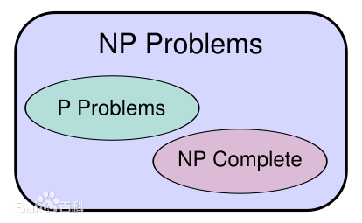
计算机理论核心问题
P 等于NP?
千禧年七大数学难题之首
https://www.win.tue.nl/~gwoegi/P-versus-NP.htm
这个网页上有106个证明，有的说是，有的说不是
一个比较通俗易懂的博客http://www.matrix67.com/blog/archives/105
Notes:
http://www.matrix67.com/blog/archives/105
下面引入P类问题的概念：如果一个问题可以找到一个能在多项式的时间里解决它的算法，那么这个问题就属于P问题。P是英文单词多项式的第一个字母。哪些问题是P类问题呢？通常NOI和NOIP不会出不属于P类问题的题目。我们常见到的一些信息奥赛的题目都是P问题。道理很简单，一个用穷举换来的非多项式级时间的超时程序不会涵盖任何有价值的算法。
问题和NP问题是计算机科学中的两个重要概念，它们涉及到算法问题的分类和解决难度。
P问题（Polynomial Time Problems）：P问题是指那些可以在多项式时间内解决的问题。换句话说，这些问题存在一个有效的算法，使得对于任何输入规模n，都能在O(n^k)的时间复杂度内找到问题的解，其中k是一个常数。这类问题被认为是相对容易解决的问题。
NP问题（Nondeterministic Polynomial Time Problems）：NP问题是指那些可以在非确定性多项式时间内验证一个解的问题。换句话说，对于一个问题，如果给定一个解，我们可以在多项式时间内验证这个解是否正确。NP问题包括了所有的P问题，因为如果一个问题可以在多项式时间内解决，那么它也可以在多项式时间内验证一个解。然而，目前尚不清楚NP问题是否可以在多项式时间内解决，这就是著名的P vs NP问题。
总结一下，P问题是指可以在多项式时间内解决的问题，而NP问题是指可以在多项式时间内验证一个解的问题。P问题通常被认为是容易解决的问题，而NP问题的难度则取决于P与NP之间的关系。

Slide 3
A Story
Suppose you work in industry, and your boss gives you the task of finding an efficient algorithm for some problem very important to the company.
After laboring long hours on the problem for over a month, you have no idea at all toward an efficient algorithm.
Giving up, you return to your boss and ashamedly announce that you simply can’t find an efficient algorithm.
Your boss: “I’m going to fire you and hire some smarter guys to solve this problem!”
You: “It is not because I’m stupid, but it is not possible to find an efficient algorithm for this problem!”
So, your boss gives you another month to prove that it is impossible.
Notes:
心里的os一定是: 你丫的, 你行你上啊, 但是肯定不能这么说

Slide 4
A Story
After a second month of hardworking, you fail again.
At this point you’ve failed to obtain an efficient algorithm and you’ve failed to prove that such an algorithm is not possible.
You are on the edge of being fired.
Suddenly, you discover that the company’s problem is similar to the 哈密顿回路 problem, and if the company’s problem is solved, it will lead to a more efficient algorithm for the 哈密顿回路 problem.

Slide 5
A Story
However, no one has ever found a more efficient algorithm for the 哈密顿回路 problem or proven that such an algorithm is not possible.
You see one last hope. If you could prove that an efficient algorithm for the company’s problem would automatically yield a more efficient algorithm for the 哈密顿回路 problem, it would mean that your boss is asking you to accomplish something that even the greatest computer scientists can’t solve.
You ask for a chance to prove this, and your boss agrees.

Slide 6
A Story
After only a week of effort, you do indeed prove that an efficient algorithm for the company’s problem would automatically yield a more efficient algorithm for the 哈密顿回路 problem.
Rather than being fired, you’re given a promotion because you have saved the company a lot of money.
Your boss now realizes that it would not be worthy to continue to expend great effort looking for an exact algorithm for the company’s problem and that other directions, such as looking for an approximate solution, should be explored.
Happy ending~

Slide 7
Computational Complexity
What we have just described is exactly what computer scientists have successfully done for the last 30 years.
Given a problem, we can’t solve it, and we can’t prove it is impossible either, so we show that are equally hard as other similar problems.
If we had an efficient algorithm for any one of them, we would have efficient algorithms for all of them.
Such an algorithm has never been found, but it’s never been proven that one is not possible.
These interesting problems are called NP-complete (NP完全) and are the focus of this lecture.

Slide 8
Decision Problem
判定问题

Slide 9

Polynomial-Time Algorithm
Definition
A polynomial-time algorithm (多项式时间算法) is one whose worst-case time complexity is bounded above by a polynomial function of its input size. That is, if $n$ is the input size, there exists a polynomial function $p(n)$ such that
$$W\left(n\right)=O\left(p\left(n\right)\right).$$
where $W\left(n\right)$ is the worst-case time complexity.
一个多项式时间算法他的最差情况复杂度是小于或者等于多项式时间的

Slide 10
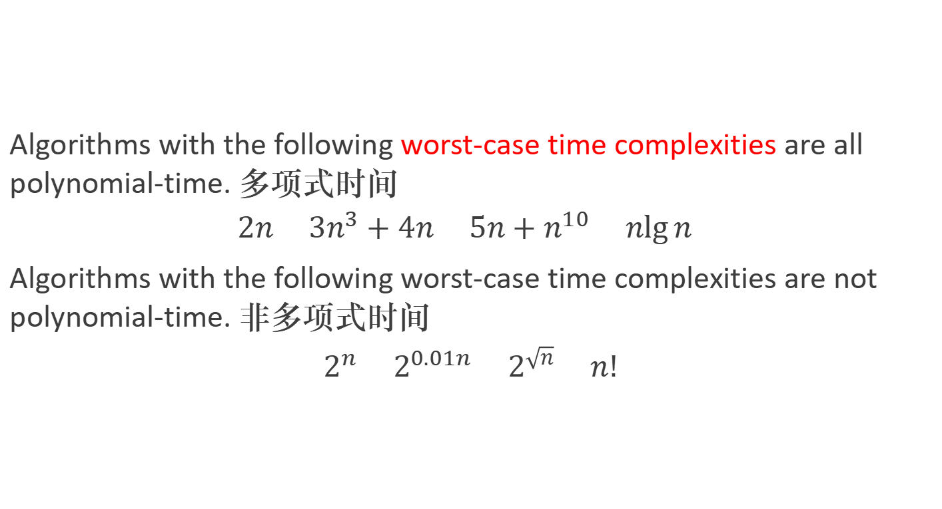
Example
Algorithms with the following worst-case time complexities are all polynomial-time. 多项式时间
$$2n 3n^{3}+4n 5n+n^{10} n\lg{n}$$
Algorithms with the following worst-case time complexities are not polynomial-time. 非多项式时间
$$2^{n} 2^{0.01n} 2^{\sqrt{n}} n!$$

Slide 11
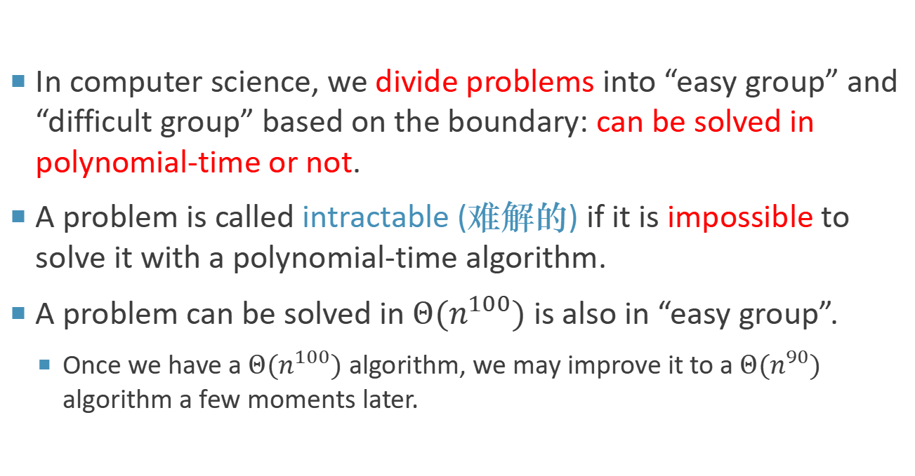
Polynomial-Time Algorithm
In computer science, we divide problems into “easy group” and “difficult group” based on the boundary: can be solved in polynomial-time or not.
A problem is called intractable (难解的) if it is impossible to solve it with a polynomial-time algorithm.
A problem can be solved in $Θ(n^{100})$ is also in “easy group”.
Once we have a $Θ(n^{100})$ algorithm, we may improve it to a $Θ(n^{90})$ algorithm a few moments later.
Notes:
就好像判刑的分水岭就是死刑, 如果没被判死刑, 判了无期, 表现好就变成40年, 然后就20年, 最后10年就出来了.

Slide 12
The Three General Problem Categories
There are three general categories of problems we concern:
Problems for which polynomial-time algorithms have been found. 找到多项式时间算法
Problems that have been proven to be intractable. 被证明了算法是非多项式的
Problems that have not been proven to be intractable, but for which polynomial-time algorithms have never been found. 不能证明是非多项式的，也找不到多项式时间算法
It is a surprising phenomenon that most problems in computer science fall into either the first or third category. 大多数计算机的问题属于1或者3
It’s extremely hard to prove the intractability of a problem (can’t find a polynomial-time algorithm for it).

Slide 13
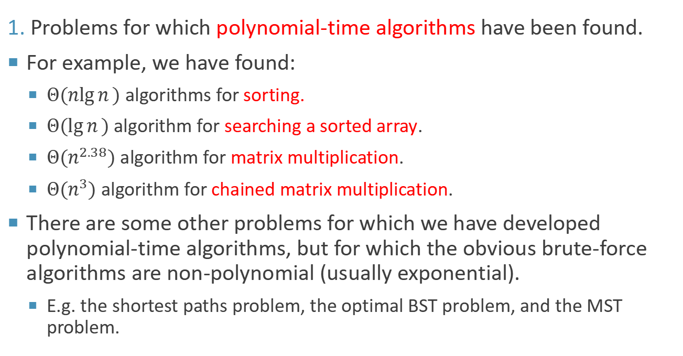
The Three General Problem Categories
1. Problems for which polynomial-time algorithms have been found.
For example, we have found:
$Θ(n\lg{n})$ algorithms for sorting.
$Θ(\lg{n})$ algorithm for searching a sorted array.
$Θ(n^{2.38})$ algorithm for matrix multiplication.
$Θ(n^{3})$ algorithm for chained matrix multiplication.
There are some other problems for which we have developed polynomial-time algorithms, but for which the obvious brute-force algorithms are non-polynomial (usually exponential).
E.g. the shortest paths problem, the optimal BST problem, and the MST problem.
Notes:
对于其他一些问题，我们已经开发了多项式时间算法，但对于这些问题，明显的暴力算法是非多项式的（通常是指数的）。
BST：log(n): 造最优二叉搜索树的动态规划算法的时间复杂度是O(n^2)。
MST最小生成树算法：

Slide 14
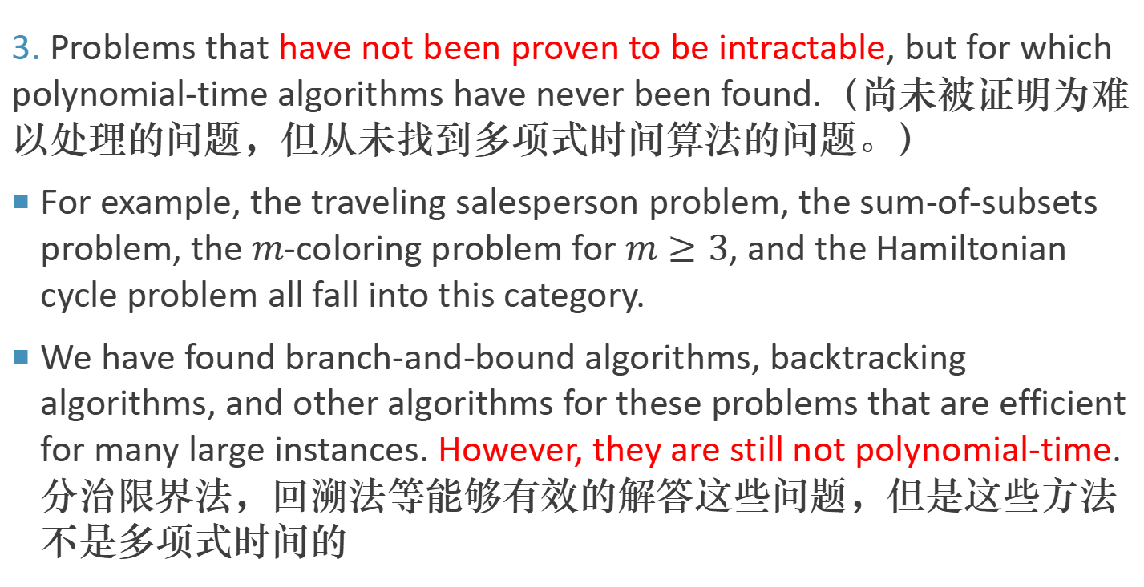
The Three General Problem Categories
3. Problems that have not been proven to be intractable, but for which polynomial-time algorithms have never been found.（尚未被证明为难以处理的问题，但从未找到多项式时间算法的问题。）
For example, the traveling salesperson problem, the sum-of-subsets problem, the $m$-coloring problem for $m≥3$, and the Hamiltonian cycle problem all fall into this category.
We have found branch-and-bound algorithms, backtracking algorithms, and other algorithms for these problems that are efficient for many large instances. However, they are still not polynomial-time. 分治限界法，回溯法等能够有效的解答这些问题，但是这些方法不是多项式时间的
Notes:
尚未被证明为难以处理的问题，但从未找到多项式时间算法的问题。
例如，旅行推销员问题、子集和问题、对于m≥3的m着色问题以及哈密尔顿循环问题都属于这一类别。

Slide 15
Decision Problem 判定问题
It is more convenient to develop the theory if we restrict ourselves to decision problems (判定问题).
我们暂时不考虑最优化等比较难的问题，我们考虑简单点的判定问题，判定问题的输出是“是”或“否”
The output of a decision problem is a simple “yes” or “no” answer.
Yet when we introduced some of the problems mentioned previously, we presented them as optimization problems.
The output is an optimal solution.
Each optimization problem has a corresponding decision problem.
Notes:
匹配问题: 找到完美匹配, 是否存在完美匹配

Slide 16
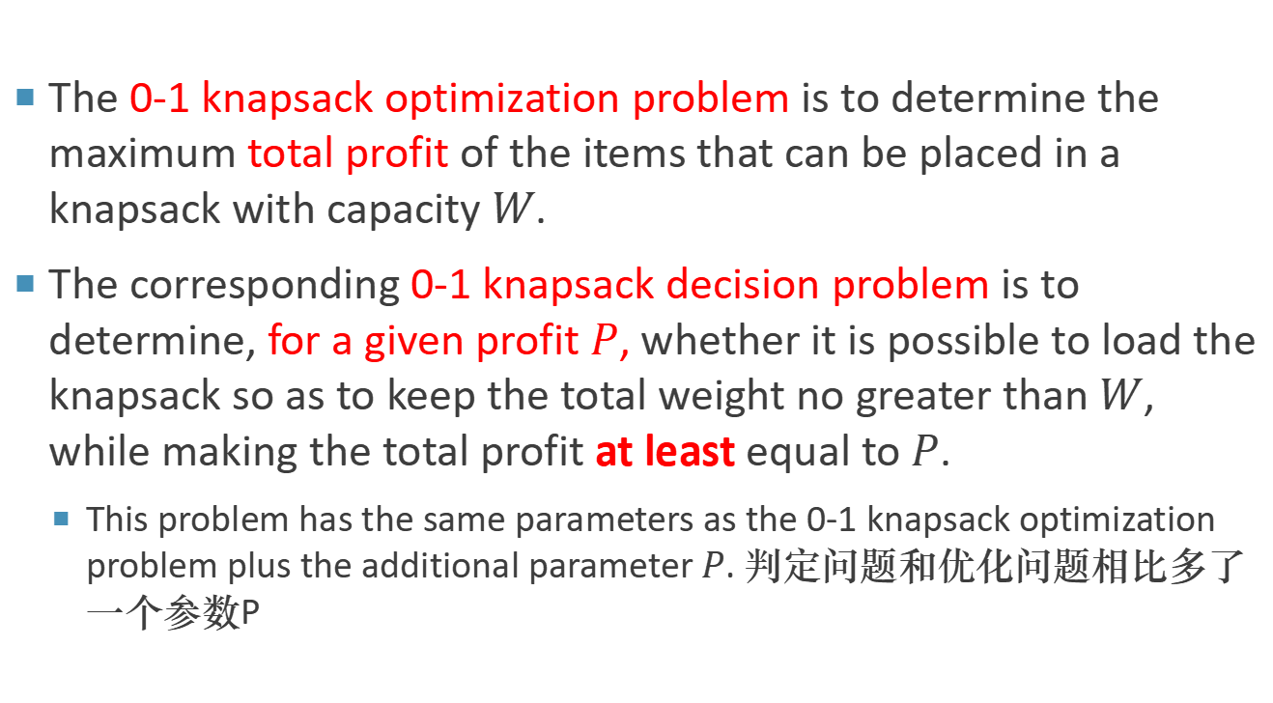
Example 将优化问题转为判定问题
The 0-1 knapsack optimization problem is to determine the maximum total profit of the items that can be placed in a knapsack with capacity $W$.
The corresponding 0-1 knapsack decision problem is to determine, for a given profit $P$, whether it is possible to load the knapsack so as to keep the total weight no greater than $W$, while making the total profit at least equal to $P$.
This problem has the same parameters as the 0-1 knapsack optimization problem plus the additional parameter $P$. 判定问题和优化问题相比多了一个参数P
https://en.wikipedia.org/wiki/Knapsack_problem
Notes:
pseudopolynomial,
Even if P≠NP, the {\displaystyle O(nW)} complexity does not contradict the fact that the knapsack problem is NP-complete, since {\displaystyle W}, unlike {\displaystyle n}, is not polynomial in the length of the input to the problem. The length of the {\displaystyle W} input to the problem is proportional to the number of bits in {\displaystyle W}, {\displaystyle \log W}, not to {\displaystyle W} itself. However, since this runtime is pseudopolynomial, this makes the (decision version of the) knapsack problem a weakly NP-complete problem.
a weakly NP-complete problem.
0-1背包优化问题是要确定能够放入容量为W的背包中的物品的最大总价值。
相应的0-1背包决策问题是要确定，对于给定的利润P，是否可以装载背包以使总重量不超过W，同时使总价值至少等于P。

Slide 17
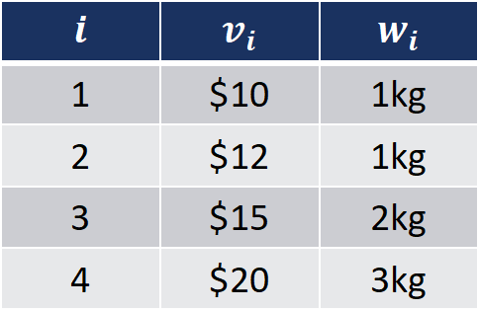
Example
Optimization problem
Decision problem
$$i$$ | $$v_{i}$$ | $$w_{i}$$
1 | $10 | 1kg
2 | $12 | 1kg
3 | $15 | 2kg
4 | $20 | 3kg
$$i$$ | $$v_{i}$$ | $$w_{i}$$
1 | $10 | 1kg
2 | $12 | 1kg
3 | $15 | 2kg
4 | $20 | 3kg
𝑊=5kg
𝑊=5kg
Can we make maximum total profit not less than 42?
我们能得到的最大利润能不少于42么？
What is the maximum total profit?
优化问题：最大利润是多少？

Slide 18
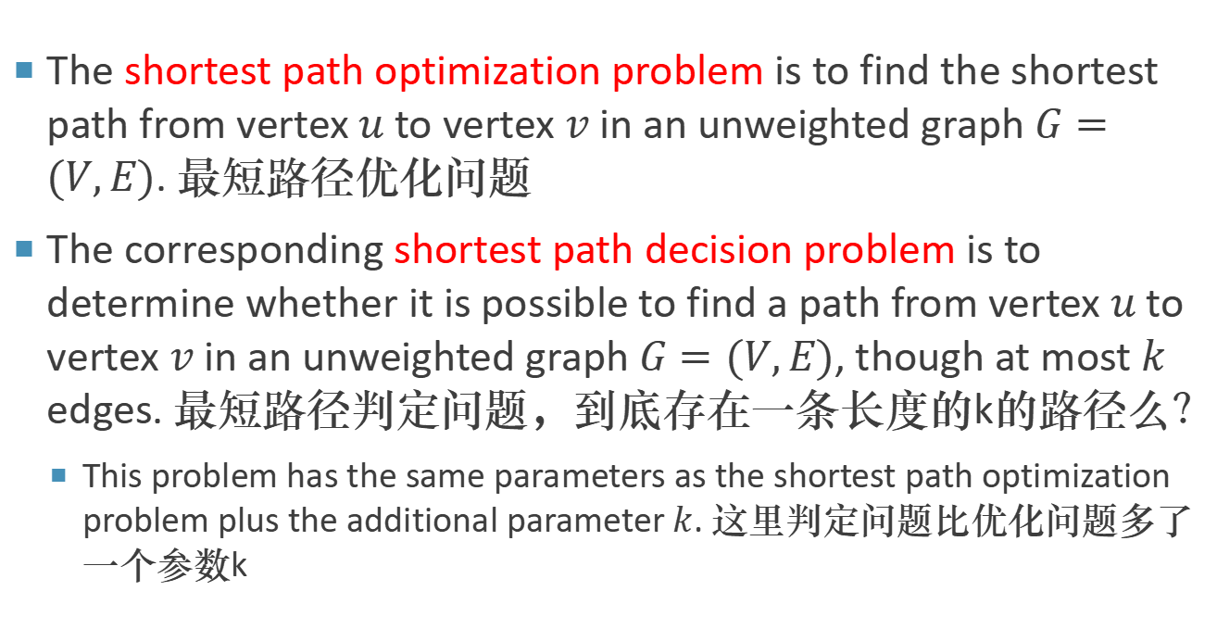
Example 最短路径问题
The shortest path optimization problem is to find the shortest path from vertex $u$ to vertex $v$ in an unweighted graph $G=(V,E)$. 最短路径优化问题
The corresponding shortest path decision problem is to determine whether it is possible to find a path from vertex $u$ to vertex $v$ in an unweighted graph $G=(V,E)$, though at most $k$ edges. 最短路径判定问题，到底存在一条长度的k的路径么？
This problem has the same parameters as the shortest path optimization problem plus the additional parameter $k$. 这里判定问题比优化问题多了一个参数k

Slide 19
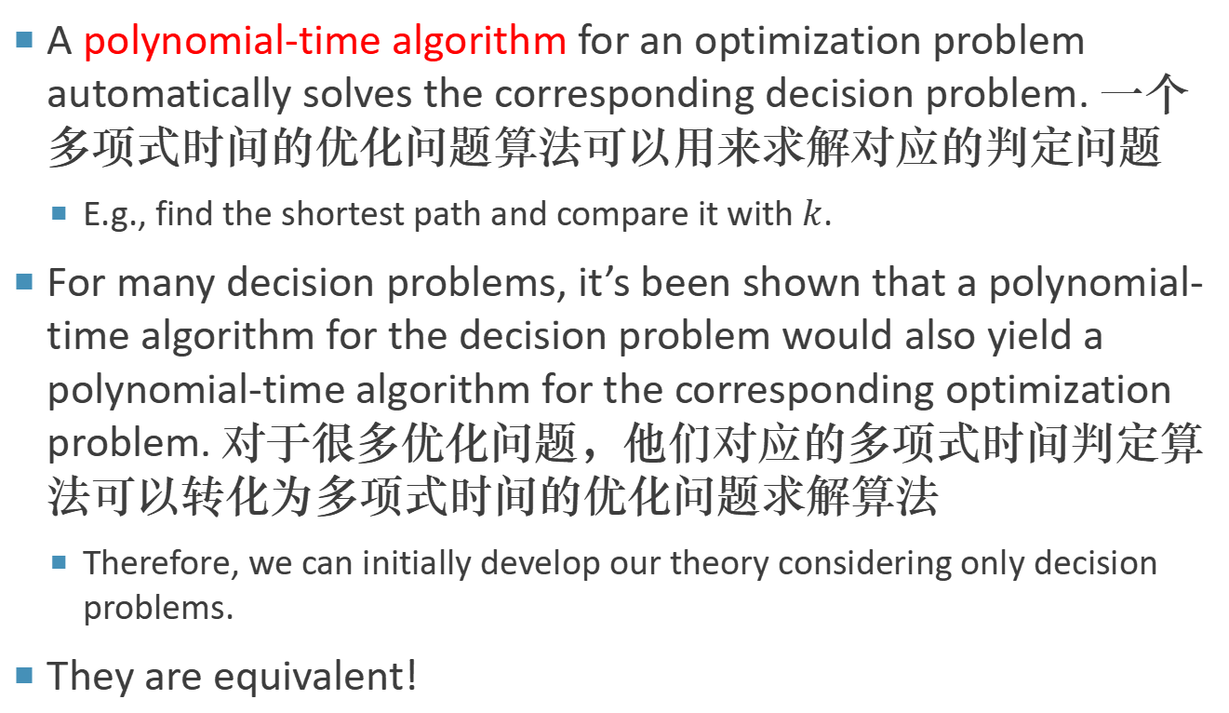
Decision Problem
A polynomial-time algorithm for an optimization problem automatically solves the corresponding decision problem. 一个多项式时间的优化问题算法可以用来求解对应的判定问题
E.g., find the shortest path and compare it with $k$.
For many decision problems, it’s been shown that a polynomial-time algorithm for the decision problem would also yield a polynomial-time algorithm for the corresponding optimization problem. 对于很多优化问题，他们对应的多项式时间判定算法可以转化为多项式时间的优化问题求解算法
Therefore, we can initially develop our theory considering only decision problems.
They are equivalent!

Slide 20

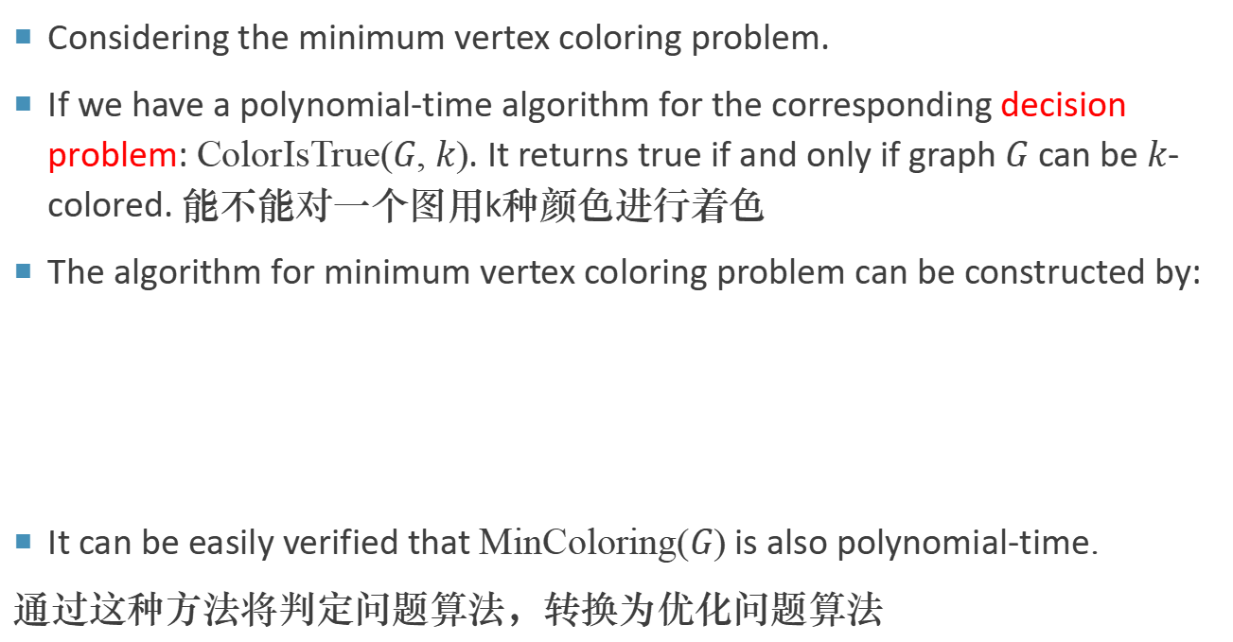
Example 最小着色问题
Considering the minimum vertex coloring problem.
If we have a polynomial-time algorithm for the corresponding decision problem: ColorIsTrue($G$, $k$). It returns true if and only if graph $G$ can be $k$-colored. 能不能对一个图用k种颜色进行着色
The algorithm for minimum vertex coloring problem can be constructed by:
It can be easily verified that MinColoring($G$) is also polynomial-time.
通过这种方法将判定问题算法，转换为优化问题算法
MinColoring($G$)
1 $k←0$
2 while ColorIsTrue($G$, $k$)$≠True$ do
3 $k←k+1$
4 return $k$

Slide 21
P and NP

Slide 22
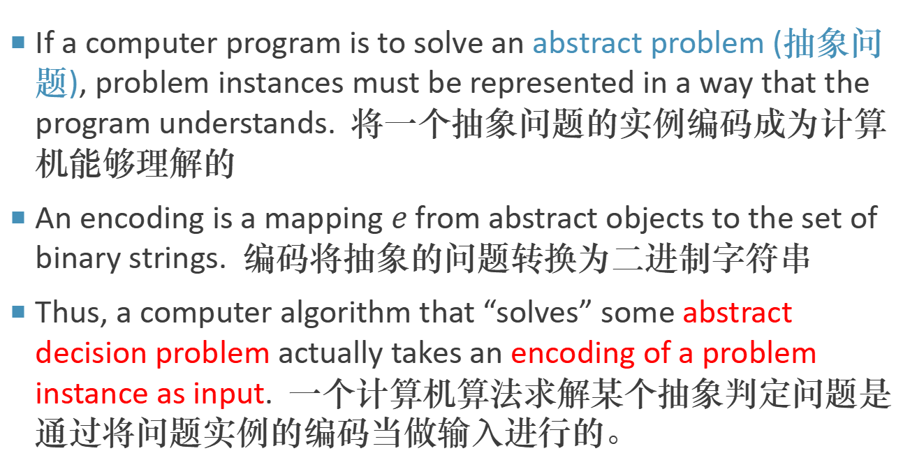
Encoding 编码
If a computer program is to solve an abstract problem (抽象问题), problem instances must be represented in a way that the program understands. 将一个抽象问题的实例编码成为计算机能够理解的
An encoding is a mapping $e$ from abstract objects to the set of binary strings. 编码将抽象的问题转换为二进制字符串
Thus, a computer algorithm that “solves” some abstract decision problem actually takes an encoding of a problem instance as input. 一个计算机算法求解某个抽象判定问题是通过将问题实例的编码当做输入进行的。

Slide 23
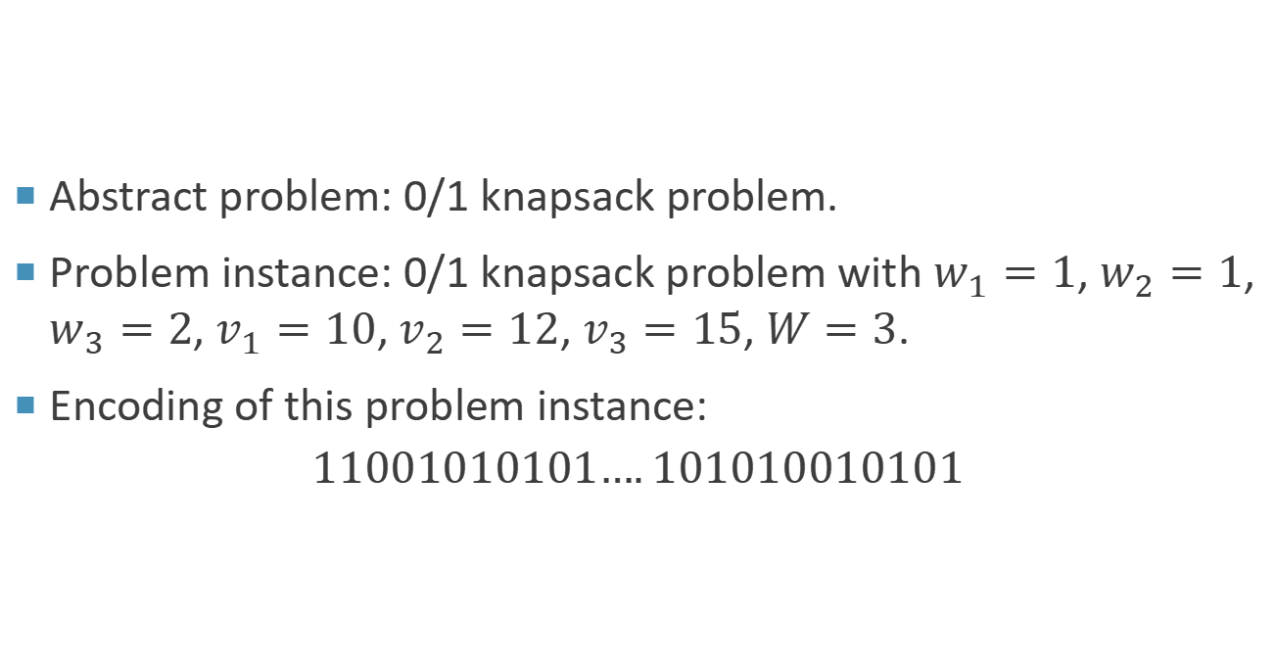
Encoding 编码示例
Abstract problem: 0/1 knapsack problem.
Problem instance: 0/1 knapsack problem with $w_{1}=1$, $w_{2}=1$, $w_{3}=2$, $v_{1}=10$, $v_{2}=12$, $v_{3}=15$, $W=3$.
Encoding of this problem instance:
$$11001010101….101010010101$$

Slide 24
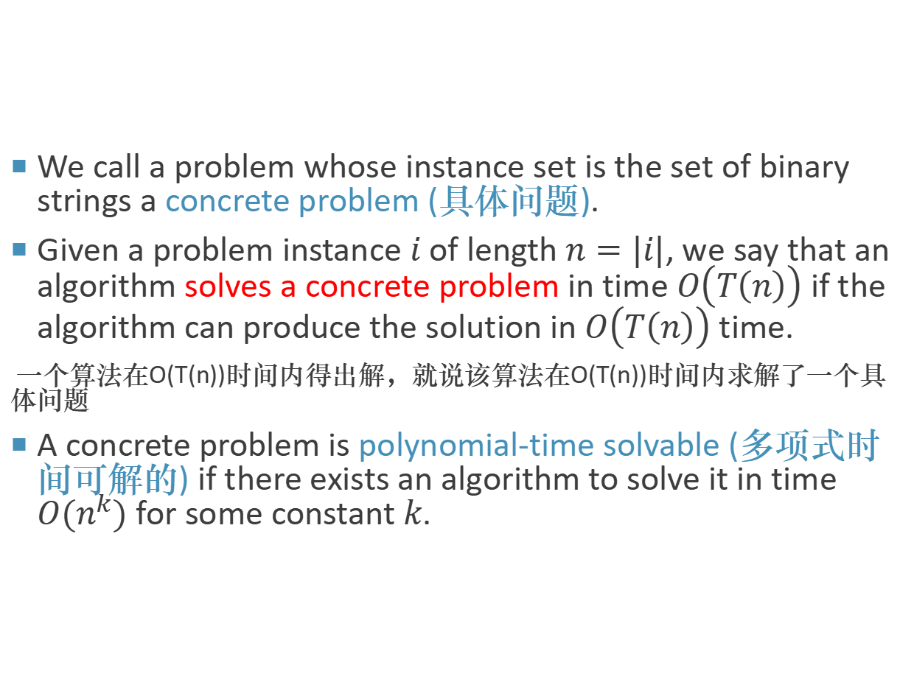
Encoding
We call a problem whose instance set is the set of binary strings a concrete problem (具体问题).
Given a problem instance $i$ of length $n=|i|$, we say that an algorithm solves a concrete problem in time $O\left(T\left(n\right)\right)$ if the algorithm can produce the solution in $O\left(T\left(n\right)\right)$ time.
一个算法在O(T(n))时间内得出解，就说该算法在O(T(n))时间内求解了一个具 体问题
A concrete problem is polynomial-time solvable (多项式时间可解的) if there exists an algorithm to solve it in time $O(n^{k})$ for some constant $k$.
Notes:
一个算法在$O\left(T\left(n\right)\right)$时间内得出解，就说该算法在$O\left(T\left(n\right)\right)$时间内求解了一个具体问题。

Slide 25
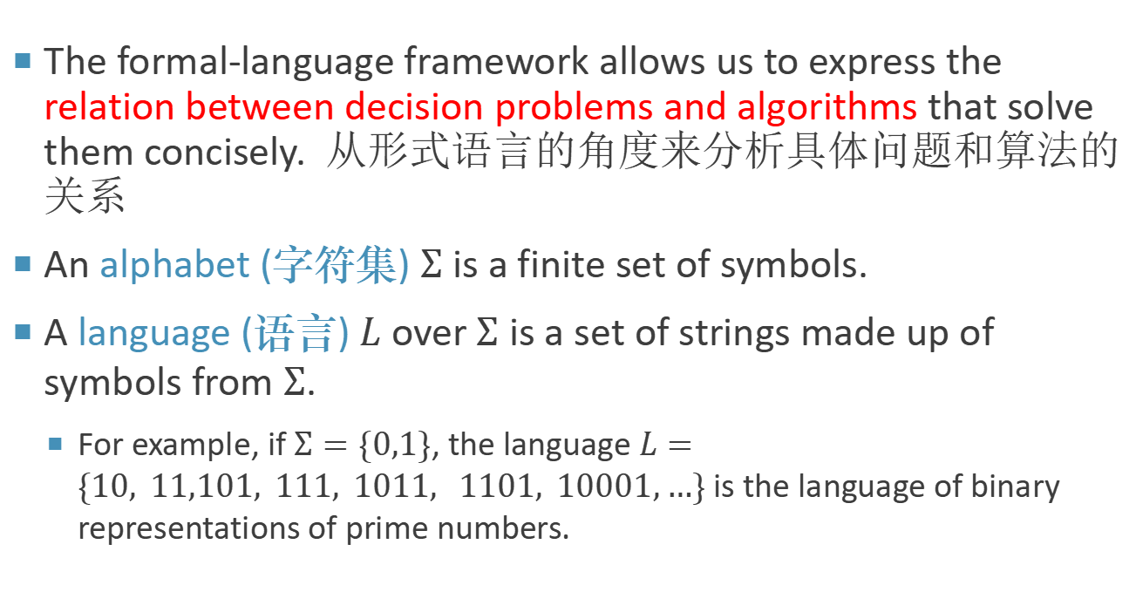
A Formal-Language Framework
The formal-language framework allows us to express the relation between decision problems and algorithms that solve them concisely. 从形式语言的角度来分析具体问题和算法的关系
An alphabet (字符集) $Σ$ is a finite set of symbols.
A language (语言) $L$ over $Σ$ is a set of strings made up of symbols from $Σ$.
For example, if $Σ=\{0,1\}$, the language $L=\{10, 11,101, 111, 1011, 1101, 10001,…\}$ is the language of binary representations of prime numbers.

Slide 26
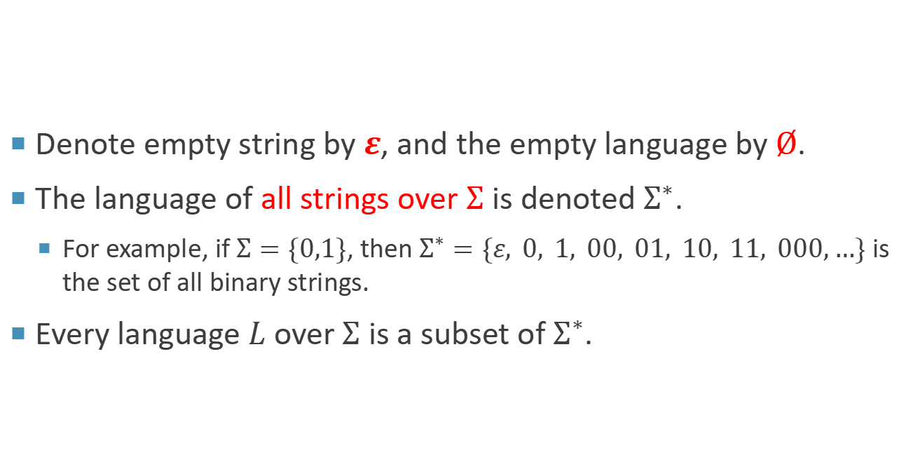
A Formal-Language Framework
Denote empty string by $ε$, and the empty language by $Ø$.
The language of all strings over $Σ$ is denoted $Σ^{∗}$.
For example, if $Σ=\{0,1\}$, then $Σ^{∗}=\{ε, 0, 1, 00, 01, 10, 11, 000,…\}$ is the set of all binary strings.
Every language $L$ over $Σ$ is a subset of $Σ^{∗}$.
Notes:
每种基于字母表 Σ 的语言 L 都是 Σ^∗ 的子集。

Slide 27
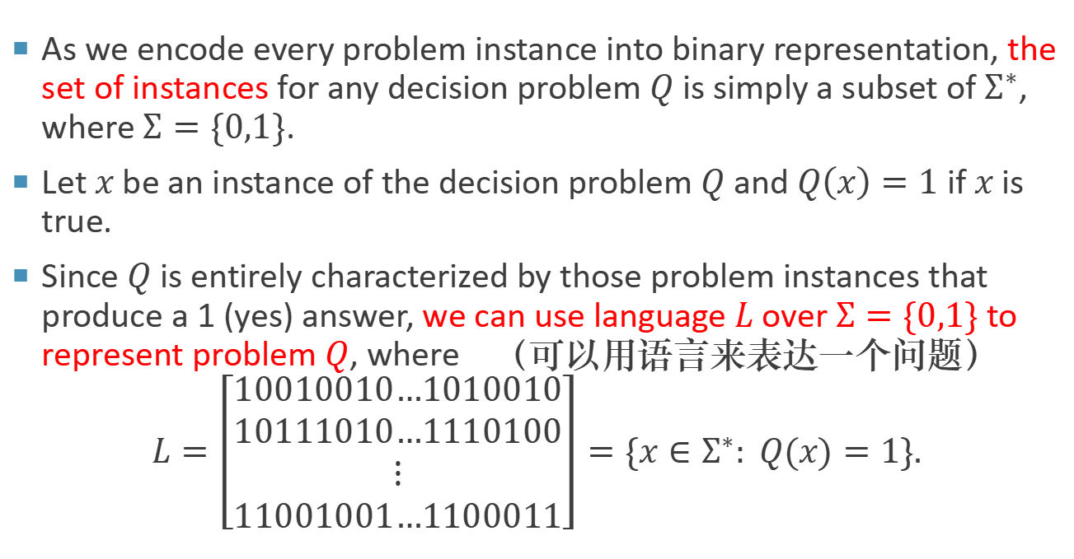
A Formal-Language Framework
As we encode every problem instance into binary representation, the set of instances for any decision problem $Q$ is simply a subset of $Σ^{∗}$, where $Σ=\{0,1\}$.
Let $x$ be an instance of the decision problem $Q$ and $Q\left(x\right)=1$ if $x$ is true.
Since $Q$ is entirely characterized by those problem instances that produce a 1 (yes) answer, we can use language $L$ over $Σ=\{0,1\}$ to represent problem $Q$, where （可以用语言来表达一个问题）
$$L=\left[\begin{matrix}10010010…1010010 \\ 10111010…1110100 \\ ⋮ \\ 11001001…1100011\end{matrix}\right]=\{x∈Σ^{∗}: Q(x)=1\}.$$
Q和L其实是一回事, Q是抽象的, L是具体的
L包含所有判定为真的问题实例
如果用另外一个字符集来表示语言，就变成了另外一个L，但是Q还是这个Q
Notes:
Q和L其实是一回事, Q是抽象的, L是具体的，L包含所有判定为真的问题实例。

Slide 28
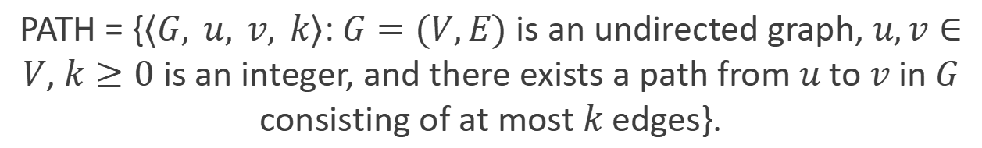
A Formal-Language Framework
Now, we can use language to represent problem.
For example, the decision problem PATH has the corresponding language:
PATH = {$⟨G, u, v, k⟩$: $G=(V,E)$ is an undirected graph, $u,v∈V$, $k≥0$ is an integer, and there exists a path from $u$ to $v$ in $G$ consisting of at most $k$ edges}.
Notes:
也可以用另一种写法来写

Slide 29

A Formal-Language Framework
Definition 11.1
We say that an algorithm $A$ accepts (接受) a string $x∈{\left\{0,1\right\}}^{∗}$ if, given input $x$, the algorithm's output $A(x)$ is 1.
The language accepted by an algorithm $A$ is the set of strings:
$$L=\{x∈{\left\{0, 1\right\}}^{∗}: A(x)=1\}$$
that is, the set of strings that the algorithm accepts.
An algorithm $A$ rejects (拒绝) a string $x$ if $A(x)=0$.
However, we can’t say that algorithm $A$ solves $L$, because we’re not sure if $A$ will reject all $x∉L$. 不能说算法A能够求解语言L
$A$ may iterate forever for such $x$. 可能无限循环
Notes:
能不能说算法A解决了语言L呢?
换句话说，一个算法能够解决特定语言
L的问题，当且仅当它满足两个条件：
对于所有属于L的字符串x，算法必须接受（输出1）。
对于所有不属于L的字符串x，算法必须拒绝（输出0），并且必须在有限步骤内做出这个决定。
如果算法在处理某些不属于L的字符串时陷入无限循环，那么我们不能认为这个算法解决了语言L的问题，因为它没有在所有情况下都能在有限的步骤内给出答案。

Slide 30

A Formal-Language Framework
Definition 11.2
A language $L$ is decided (判定) by an algorithm $A$ if $∀x∈L$ is accepted by $A$ and $∀x∉L$ is rejected by $A$. 如果一个算法A接受L中的每个串，并且拒绝不在L中的串，就称A能够判定语言L
A language $L$ is accepted 接受 in polynomial time by an algorithm $A$ if there is a constant $k$ such that for any length-$n$ string $x∈L$, algorithm $A$ accepts $x$ in time $O(n^{k})$.
A language $L$ is decided 判定 in polynomial time by an algorithm $A$ if there is a constant $k$ such that for any length-$n$ string $x∈{\left\{0,1\right\}}^{∗}$, algorithm $A$ correctly decides whether $x∈L$ in time $O(n^{k})$.
判定的要求比接受更高，判定要求不仅仅能够在多项式时间接受L中的串，并且要在多项式时间拒绝不在L中的串

Slide 31

A Formal-Language Framework
We can informally define a complexity class (复杂类) as a set of languages, membership in which is determined by a complexity measure, such as running time, of an algorithm that determines whether a given string $x$ belongs to language $L$. 复杂类是语言的集合，比如按照某种时间复杂度将这些语言归类在一起
Using this language-theoretic framework, we can provide an alternative definition of the complexity class P:
Definition 11.3
P = {$L∈{\left\{0, 1\right\}}^{∗}$ : there exists an algorithm $A$ that decides $L$ in polynomial time}. P是指有算法能在多项式时间内判定的语言的集合
Theorem 11.1
P = {$L$ : $L$ is accepted by a polynomial-time algorithm}.
Notes:
绕了这么大一个圈, 我们想做的就是用形式化语言来再次定义P.
要在多项式时间内回答yes or no.判定比接受更难，如果能够在多项式时间内判定，那么肯定在多项式时间内能接受。具体证明通过将判定算法改为接受算法即可

Slide 32
P and NP
All decision problems for which we have found polynomial-time algorithms are certainly in P. 所有的我们能找到多项式时间复杂度算法的问题，肯定是P问题
Searching, sorting, matrix multiplication…
However, could some decision problem like Hamiltonian Graph decision problem for which we have not found a polynomial-time algorithm also be in P?
We don’t know! It could possibly be in P.
No one finds a polynomial-time algorithm and no one proves that it is not in P.

Slide 33
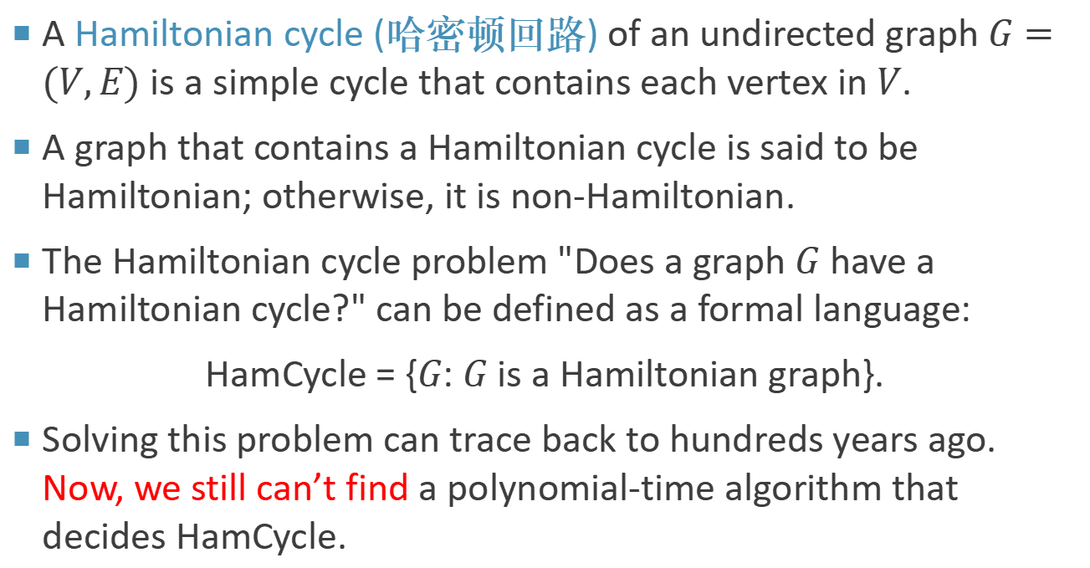
Hamiltonian Cycle Problem
A Hamiltonian cycle (哈密顿回路) of an undirected graph $G=(V,E)$ is a simple cycle that contains each vertex in $V$.
A graph that contains a Hamiltonian cycle is said to be Hamiltonian; otherwise, it is non-Hamiltonian.
The Hamiltonian cycle problem "Does a graph $G$ have a Hamiltonian cycle?" can be defined as a formal language:
HamCycle = {$G$: $G$ is a Hamiltonian graph}.
Solving this problem can trace back to hundreds years ago. Now, we still can’t find a polynomial-time algorithm that decides HamCycle.

Slide 34
P and NP
It seems that the research on this kind of hard problem gets stuck.
Instead, for this kind of decision problem like Hamiltonian Cycle decision problem, we’d like to if we can verify an answer in polynimial-time. 对于不确定能不能找到多项式时间判定算法的问题，我们希望知道能不能在多项式时间内验证其中某个答案的正确性

Slide 35
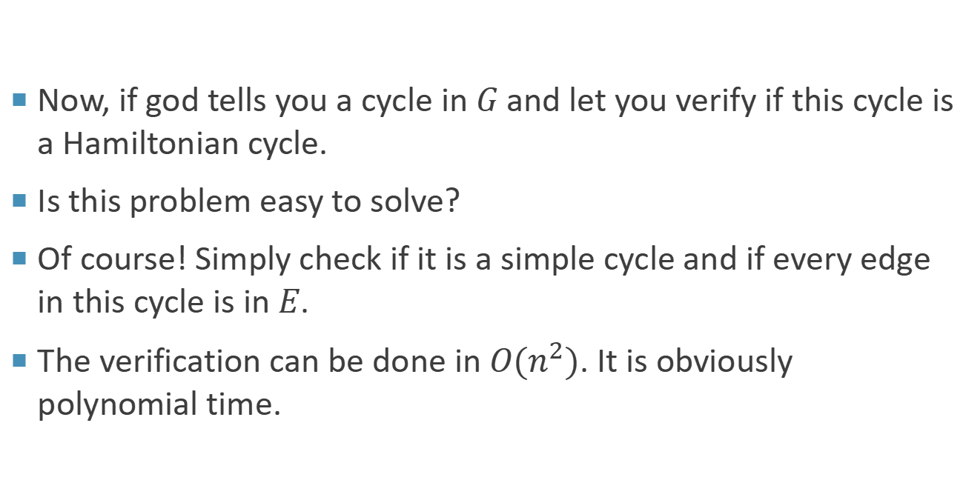
Hamiltonian Cycle Problem
Now, if god tells you a cycle in $G$ and let you verify if this cycle is a Hamiltonian cycle.
Is this problem easy to solve?
Of course! Simply check if it is a simple cycle and if every edge in this cycle is in $E$.
The verification can be done in $O(n^{2})$. It is obviously polynomial time.

Slide 36
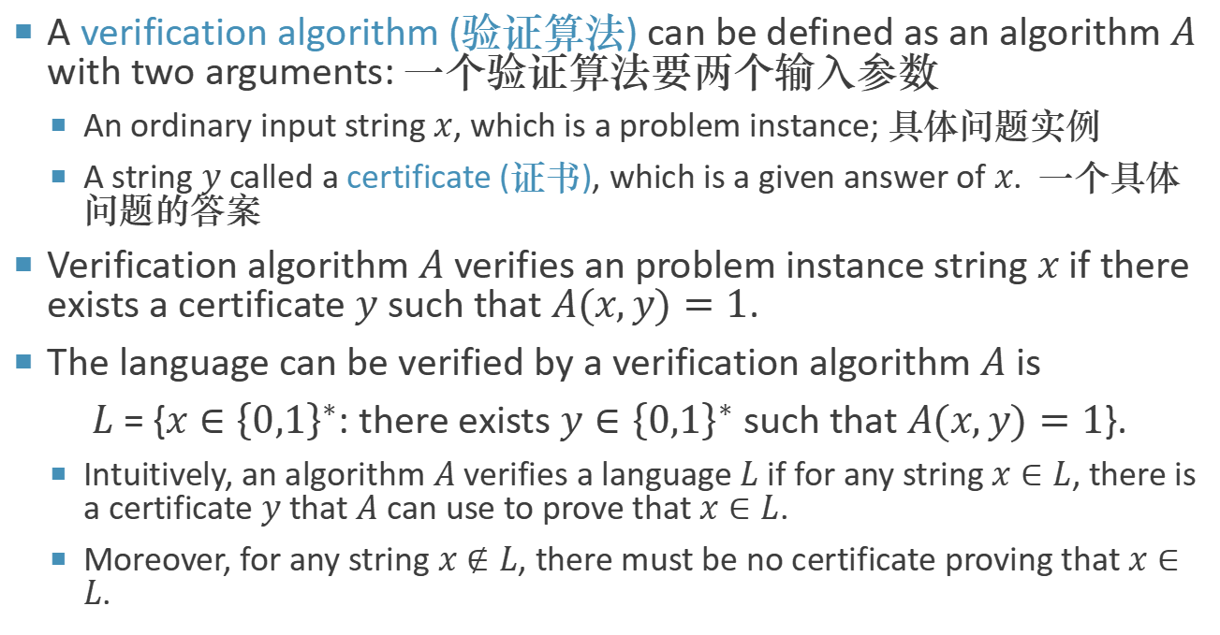
Verification Algorithms 验证算法
A verification algorithm (验证算法) can be defined as an algorithm $A$ with two arguments: 一个验证算法要两个输入参数
An ordinary input string $x$, which is a problem instance; 具体问题实例
A string $y$ called a certificate (证书), which is a given answer of $x$. 一个具体问题的答案
Verification algorithm $A$ verifies an problem instance string $x$ if there exists a certificate $y$ such that $A(x,y)=1$.
The language can be verified by a verification algorithm $A$ is
$L$ = {$x∈{\left\{0,1\right\}}^{∗}$: there exists $y∈{\left\{0,1\right\}}^{∗}$ such that $A(x,y)=1$}.
Intuitively, an algorithm $A$ verifies a language $L$ if for any string $x∈L$, there is a certificate $y$ that $A$ can use to prove that $x∈L$.
Moreover, for any string $x∉L$, there must be no certificate proving that $x∈L$.

Slide 37
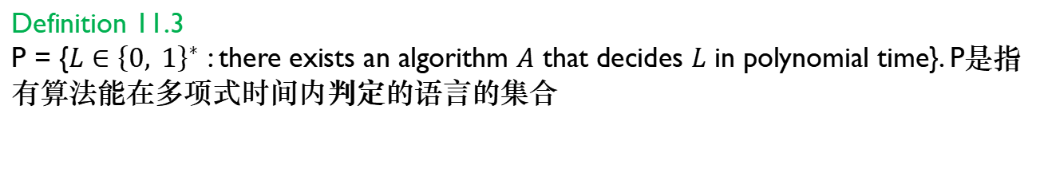
NP
Definition 11.3
P = {$L∈{\left\{0, 1\right\}}^{∗}$ : there exists an algorithm $A$ that decides $L$ in polynomial time}. P是指有算法能在多项式时间内判定的语言的集合
Definition 11.4
The complexity class NP is the class of languages that can be verified by a polynomial-time algorithm. 在多项式时间里面被验证
Notice that NP stands for “non-deterministic polynomial”, rather than “non-polynomial”.
What is non-deterministic???

Slide 38
Nondeterministic Algorithm
To state the notion of polynomial-time verifiability more concretely, we introduce the concept of a non-deterministic algorithm (非确定性算法).
We can think of such an algorithm as being composed of the following two separate stages:
Guessing (Non-deterministic) Stage: Guess a solution to the given instance. It is called non-deterministic because this stage is totally random.
Verification (Deterministic) Stage: Verify the answer: (1) the answer for this instance is “yes”, (2) the answer for this instance is “no”, or (3) can’t verify at all (that is, going into an infinite loop). It is called deterministic because only “yes” or “no” can be produced in this stage.
Notes:
为了更具体地说明多项式时间可验证性的概念，我们引入了非确定性算法的概念(非确定性算法).

Slide 39
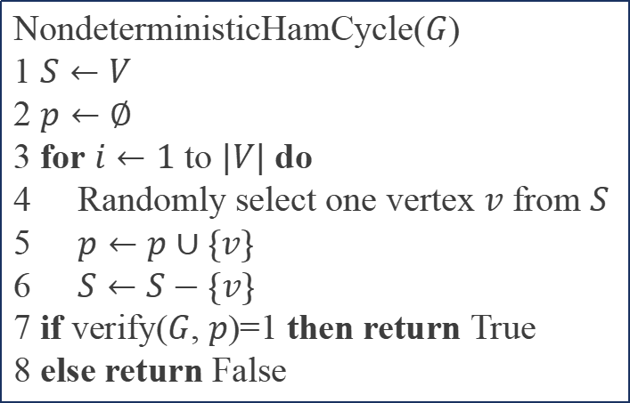
Nondeterministic Algorithm
For the Hamiltonian cycle problem, we can design a nondeterministic algorithm:
NondeterministicHamCycle($G$)
1 $S←V$
2 $p←∅$
3 for $i←1$ to $|V|$ do
Randomly select one vertex $v$ from $S$
5 $p←p∪\{v\}$
6 $S←S−\{v\}$
7 if verify($G$, $p$)=1 then return True
8 else return False

Slide 40
Polynomial-Time Nondeterministic Algorithm
Definition
A polynomial-time non-deterministic algorithm is a non-deterministic algorithm whose verification stage is a polynomial-time algorithm. 多项式时间非确定性算法的验证阶段时多项式时间的
Definition
NP is the set of all decision problems that can be solved by polynomial-time non-deterministic algorithms. NP就是所有能够被多项式非确定算法所求解的判定问题集合
We are not sure if one can be solved in polynomial-time, but we know that we can verify an answer of it in polynomial-time.
This definition is equivalent to the previous definition.
Notes:
现在知道为什么我们要讨论判定问题了吧?
只有判定问题, 才可以建立多项式时间的验证算法.

Slide 41
P and NP
There are thousands of problems that no one has been able to solve with polynomial-time algorithms but that have been proven to be in NP because polynomial-time nondeterministic algorithms have been developed for them.
The answers to them can be verified in polynomial-time.
Every problem in P is also in NP. 所有的P问题都是NP问题
This is trivially true because any problem in P can be solved by a polynomial-time algorithm.
When it is solved, it is also verified.
There are only few problems that have been proved not in NP.
The intractable problems, e.g. the Halting problem
有一些问题不是NP问题，比如停机问题
Notes:
当我们写代码调试的时候, 有时会遇到这样一种情况: 等了很久, 程序还一直在运行. 我们不知道是代码在正常运行只是运行时间比较久, 还是代码写的有问题(比如写了死循环)导致程序根本不会停止. 这时候我们想, 如果能有个工具能为我们判断我们写的代码的运行时间就好了. 这就是停机问题.
不失一般性, 假设我们想要测试的代码是一个函数
void f(char *t);
其中t是一个字符串, 我们可以用一个字符串表示任意输入, 包括int, double, 及复合数据类型; 当f不需要输入时, t是一个空字符串. 停机问题是指对给定任意的一个函数f和输入t, 判断f对t是否会永远运行下去; 如果程序的运行时间是有限长的, 我们称f对t停机.
遗憾的是, 不存在这样的一个工具使得其能判断任意f的停机问题, 即停机问题不可判定.
停机问题的本质是不存在一个通用程序能够判断所有可能的程序对给定输入是否会在有限时间内停机。
它询问是否存在一个程序能够判断任意给定的程序在有限的计算时间内是否会停止运行。 作者：张皓 链接：https://www.zhihu.com/question/20081359/answer/162329455 来源：知乎 著作权归作者所有。商业转载请联系作者获得授权，非商业转载请注明出处。

Slide 42
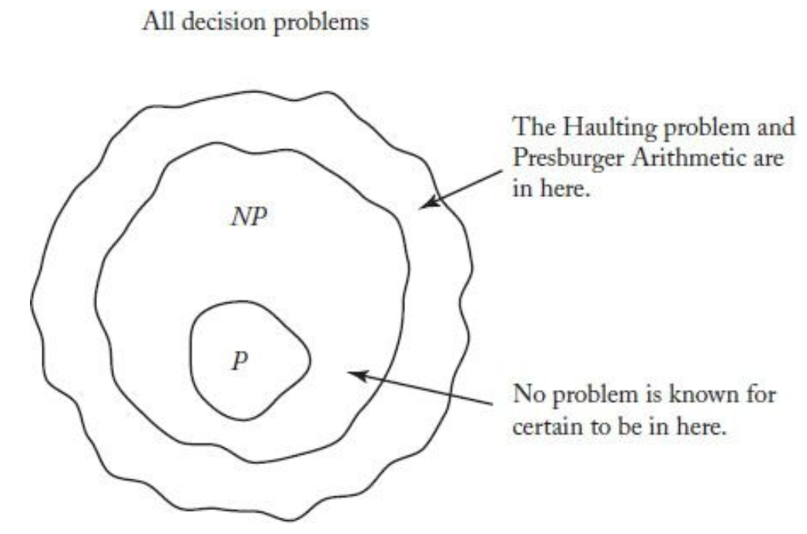
P and NP
Because P is in NP, it is easy to think that NP contains P as a proper subset.
However, this may not be the case. That is, no one has ever proven that there is a problem in NP that is not in P. 目前没有人能够找到不是P的一个NP问题
No one knows if P=NP or not yet.
If P=NP, it means that once we can verify answer of a problem in polynomial-time, we can solve it in polynomial-time! 如果 P=NP，意味着如果我们能够在多项式时间内验证一个问题的答案，那么我们也能在多项式时间内求解他
Image source: Figure 9.3, Richard E. Neapolitan, Foundations of Algorithms (5th Edition), Jones & Bartlett Learning, 2014
Notes:
想想是不是很神奇, 明明验证感觉要容易很多
这就好比P是找到女朋友, 但是NP是给你一个女生, 问你喜不喜欢, 也就是你知道自己喜欢的类型.
现在好了, 如果P=NP, 说明只要知道自己喜欢的类型, 就一定可以找到.
但是也没办反证明, 知道自己喜欢的类型, 就一定找不到.

Slide 43


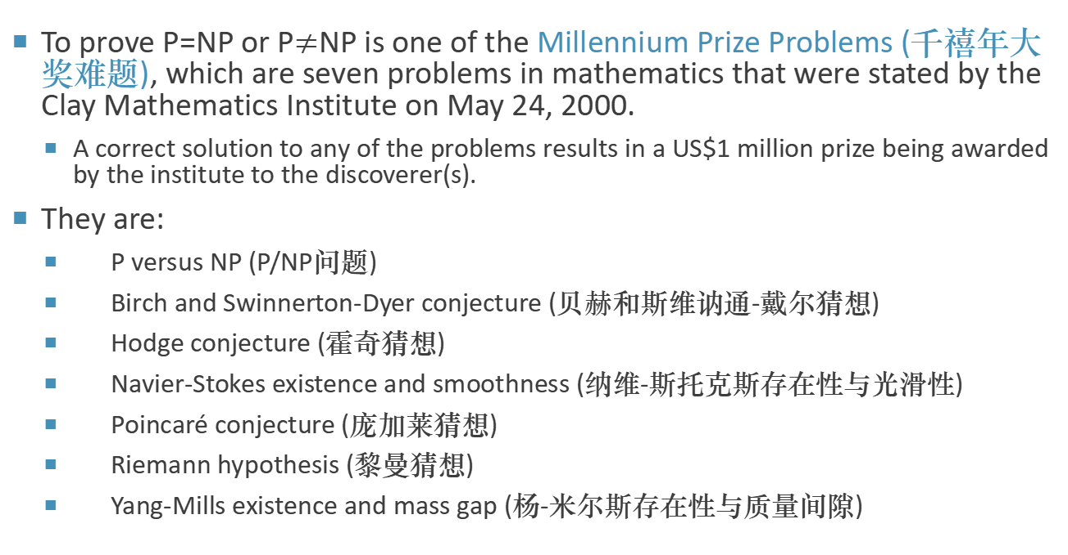
P=NP?
To prove P=NP or P$≠$NP is one of the Millennium Prize Problems (千禧年大奖难题), which are seven problems in mathematics that were stated by the Clay Mathematics Institute on May 24, 2000.
A correct solution to any of the problems results in a US$1 million prize being awarded by the institute to the discoverer(s).
They are:
P versus NP (P/NP问题)
Birch and Swinnerton-Dyer conjecture (贝赫和斯维讷通-戴尔猜想)
Hodge conjecture (霍奇猜想)
Navier-Stokes existence and smoothness (纳维-斯托克斯存在性与光滑性)
Poincaré conjecture (庞加莱猜想)
Riemann hypothesis (黎曼猜想)
Yang-Mills existence and mass gap (杨-米尔斯存在性与质量间隙)
Statistic source: http://www.cs.umd.edu/~gasarch/papers/poll.pdf
Notes:
佩雷尔曼解决了庞佳莱猜想
克莱数学研究所，100万都是小事儿了, 名留青史才是大事儿
但是对于纯粹的数学家, 名留青史都不是大事儿, 对真理的极致追求才是大事儿
https://www.bilibili.com/video/BV1mV41127A1?p=1&share_medium=iphone&share_plat=ios&share_source=WEIXIN&share_tag=s_i&timestamp=1622467758&unique_k=lV9N5u

Slide 44
P=NP?
Statistic source: http://www.cs.umd.edu/~gasarch/papers/poll.pdf
Notes:
大家也举手表态一下

Slide 45
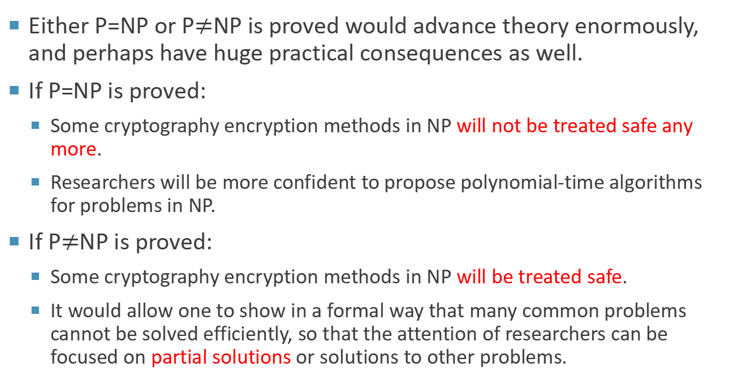
Consequences of Solution
Either P=NP or P$≠$NP is proved would advance theory enormously, and perhaps have huge practical consequences as well.
If P=NP is proved:
Some cryptography encryption methods in NP will not be treated safe any more.
Researchers will be more confident to propose polynomial-time algorithms for problems in NP.
If P$≠$NP is proved:
Some cryptography encryption methods in NP will be treated safe.
It would allow one to show in a formal way that many common problems cannot be solved efficiently, so that the attention of researchers can be focused on partial solutions or solutions to other problems.
Notes:
大家可能觉得, p等不等np关我屁事
网安的同学
如果证明了P=NP：
一些在NP中的密码学加密方法将不再被视为安全。
研究人员会更有信心提出针对NP问题多项式时间的算法。
如果证明了P≠NP：
一些在NP中的密码学加密方法将被认为安全。
这将允许人们以正式的方式表明，许多常见问题无法高效解决，因此研究人员可以将注意力集中在部分解决方案或其他问题的解决上。

Slide 46
NP Complete

Slide 47
NP Complete
There are a lot of problems:
No polynomial-time algorithm is found; 没有找到多项式时间算法
Can’t prove it is impossible to find a polynomial-time algorithm. 不能证明找不到多项式时间算法
There is a special group among these problems. If a polynomial-time algorithm is developed for one of it, every problem in this group can be solved in polynomial time. 一些问题，如果能找到其中一个问题的多项式时间算法，那么所有的这些问题都能在多项式时间内解决
This group is called NP complete.
There are more than 3000 known NP-complete problems. See here for some typical ones.
Notes:
就和之前说的那个例子一样

Slide 48




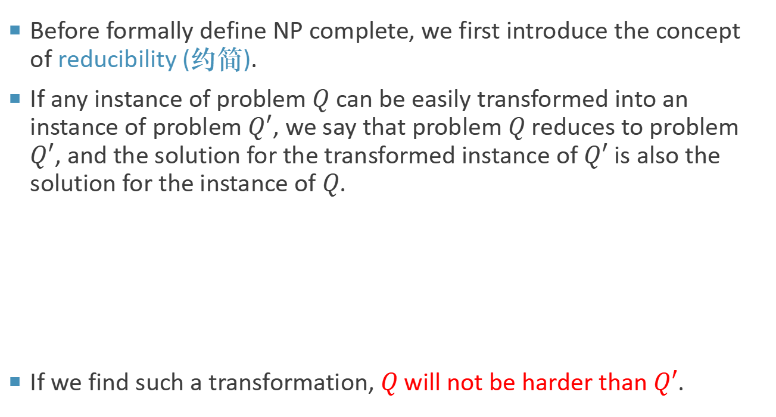
Reducibility
Before formally define NP complete, we first introduce the concept of reducibility (约简).
If any instance of problem $Q$ can be easily transformed into an instance of problem $Q′$, we say that problem $Q$ reduces to problem $Q′$, and the solution for the transformed instance of $Q′$ is also the solution for the instance of $Q$.
If we find such a transformation, $Q$ will not be harder than $Q′$.
Instance of $Q$
transform
Instance of $Q′$
solve
Solution for
instance of $Q$
transform
Solution for
instance of $Q′$

Slide 49
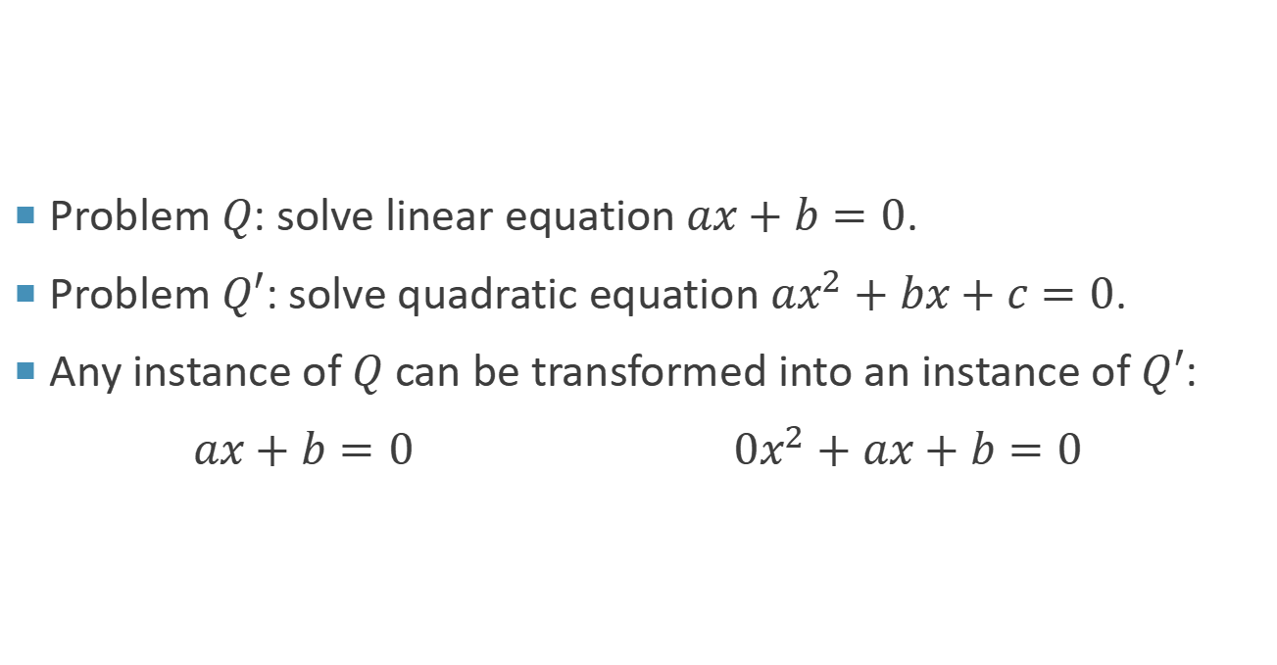
Example
Problem $Q$: solve linear equation $ax+b=0$.
Problem $Q′$: solve quadratic equation $ax^{2}+bx+c=0$.
Any instance of $Q$ can be transformed into an instance of $Q′$:
$ax+b=0$ $0x^{2}+ax+b=0$
Notes:
如果我能解决2次, 那我一定能解决1次

Slide 50

Reducibility
Definition 11.6
A language $L_{1}$ is polynomial-time reducible to a language $L_{2}$, written $L_{1}≤_{P}L_{2}$, if there exists a polynomial-time computable function $f: {\left\{0, 1\right\}}^{∗}→{\left\{0,1\right\}}^{∗}$ such that for all $x∈{\left\{0,1\right\}}^{∗}$,
$$x∈L_{1} if and only if f(x)∈L_{2}$$
We call the function $f$ the reduction function (约简函数), and a polynomial-time algorithm $A$ that computes $f$ is called a reduction algorithm (约简算法).
The symbol $≤_{P}$ means polynomial-time reducible. $L_{1}≤_{P}L_{2}$ indicates the difficulty of $L_{1}$ will not be higher than $L_{2}$.

Slide 51




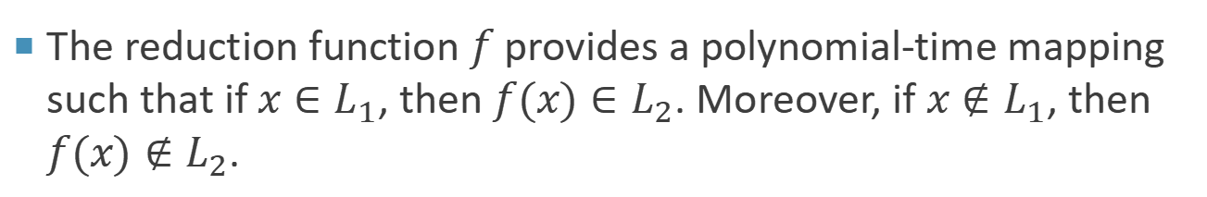
Reducibility
The reduction function $f$ provides a polynomial-time mapping such that if $x∈L_{1}$, then $f(x)∈L_{2}$. Moreover, if $x∉L_{1}$, then $f(x)∉L_{2}$.
$$f$$
$$L_{1}$$
$$L_{2}$$
$${\left\{0, 1\right\}}^{∗}$$
$${\left\{0, 1\right\}}^{∗}$$
Notes:
依然有函数的概念, 只能多对一, 不能一对多

Slide 52
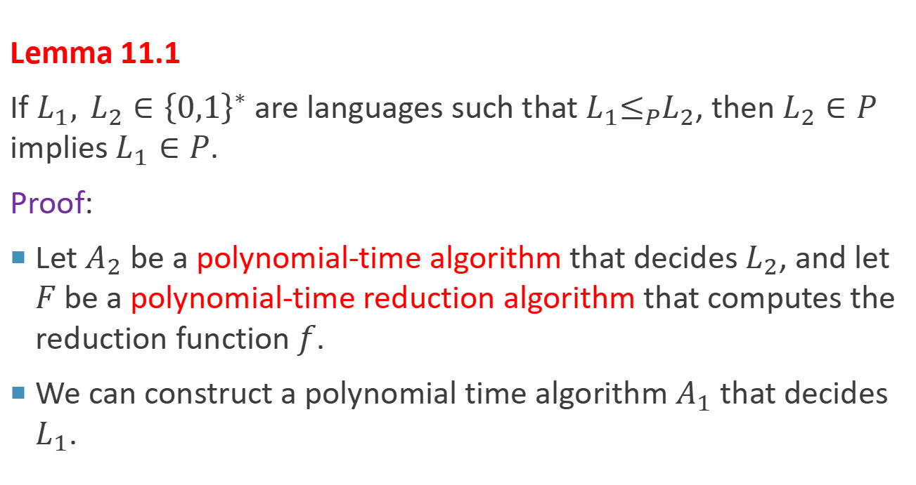
Reducibility
Lemma 11.1
If $L_{1}, L_{2}∈{\left\{0,1\right\}}^{∗}$ are languages such that $L_{1}≤_{P}L_{2}$, then $L_{2}∈P$ implies $L_{1}∈P$.
Proof:
Let $A_{2}$ be a polynomial-time algorithm that decides $L_{2}$, and let $F$ be a polynomial-time reduction algorithm that computes the reduction function $f$.
We can construct a polynomial time algorithm $A_{1}$ that decides $L_{1}$.

Slide 53









Reducibility
Polynomial time
$$yes, f(x)∈L_{2}$$
$$yes, x∈L_{1}$$
$$x$$
$$F$$
$$f(x)$$
$$A_{2}$$
$$no, f(x)∉L_{2}$$
$$no, x∉L_{1}$$
Polynomial time
$$A_{1}$$
Polynomial time
Notes:
约简算法

Slide 54

NP-Completeness
Polynomial-time reductions provide a formal means for showing that one problem is at least as hard as another, to within a polynomial-time factor.
Definition 11.7
A language $L∈{\left\{0,1\right\}}^{∗}$ is NP-complete (NPC, NP完全) if
1. $L∈NP$, and
2. $L^{′}≤_{P}L$ for every $L′∈NP$.
If a language $L$ satisfies property 2, but not necessarily （不一定满足） property 1, we say that $L$ is NP-hard (NP难).
Usually, the optimization problem of an NPC decision problem is NP-hard, because verifying an optimization problem is not in NP.
Notes:
NPC, 作为计科学生第一反应就应该是NP完全, 而不是游戏里只会永远重复同一句话的人.
问: 优化问题为什么不是NP?
一个NPC决策问题的优化问题是NP难的，因为验证一个优化问题不在NP中。

Slide 55
NP-Completeness
A problem is NP-complete if it is both in NP and NP-hard.
The NP-complete problems represent the hardest problems in NP. NPC问题是NP问题中最难的 （只是NP问题里面最难的）
If any NP-complete problem has a polynomial time algorithm, all problems in NP do. 如果一个NPC问题有多项式时间算法，所有的NP问题都有多项式时间算法
Theorem 11.2
If any NP-complete problem is polynomial-time solvable, then P=NP. Equivalently, if any problem in NP is not polynomial-time solvable, then no NP-complete problem is polynomial time solvable.
Notes:
从难度不会超过的角度解释

Slide 56
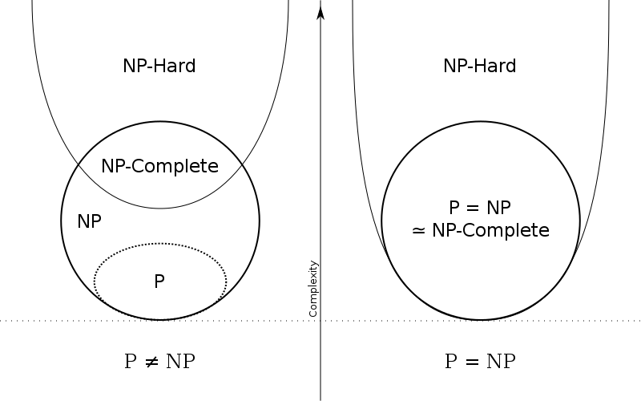
NP-Completeness
Image source: https://en.wikipedia.org/wiki/NP-completeness
Notes:
有几个特例是NP但是不是NPC
这个我不是很懂啊

Slide 57
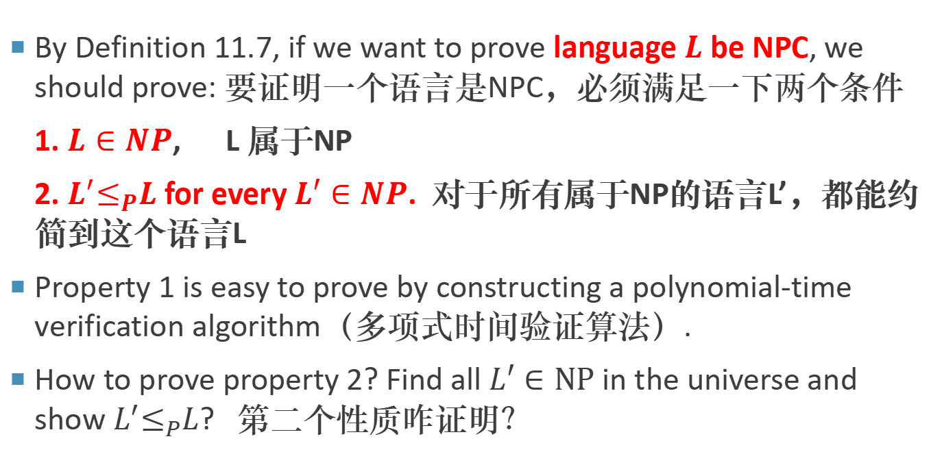
NP-Completeness Proofs
By Definition 11.7, if we want to prove language $L$ be NPC, we should prove: 要证明一个语言是NPC，必须满足一下两个条件
1. $L∈NP$, L 属于NP
2. $L^{′}≤_{P}L$ for every $L′∈NP$. 对于所有属于NP的语言L’，都能约简到这个语言L
Property 1 is easy to prove by constructing a polynomial-time verification algorithm（多项式时间验证算法）.
How to prove property 2? Find all $L′∈NP$in the universe and show $L^{′}≤_{P}L$? 第二个性质咋证明？
Notes:
找到全宇宙的NP问题, 然后证明能够约简到L
这也太难了吧, 那怎么办呢?

Slide 58
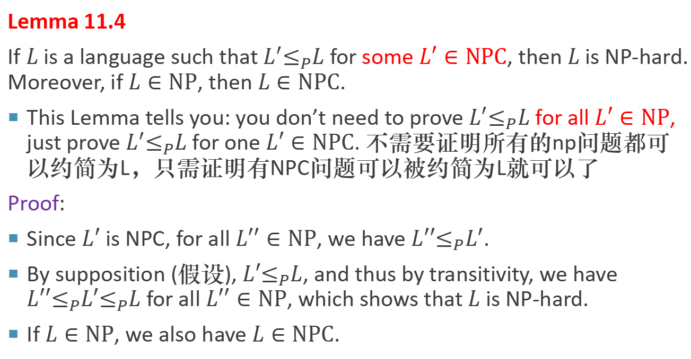
NP-Completeness Proofs
如果能把一个NPC的语言约简为L，那么L是NP-hard，如果L还是NP的，那么L是NPC
Lemma 11.4
If $L$ is a language such that $L^{′}≤_{P}L$ for some $L′∈NPC$, then $L$ is NP-hard. Moreover, if $L∈NP$, then $L∈NPC$.
This Lemma tells you: you don’t need to prove $L^{′}≤_{P}L$ for all $L′∈NP$, just prove $L^{′}≤_{P}L$ for one $L′∈NPC$. 不需要证明所有的np问题都可以约简为L，只需证明有NPC问题可以被约简为L就可以了
Proof:
Since $L′$ is NPC, for all $L′′∈NP$, we have $L′′≤_{P}L′$.
By supposition (假设), $L′≤_{P}L$, and thus by transitivity, we have $L′′≤_{P}L′≤_{P}L$ for all $L′′∈NP$, which shows that $L$ is NP-hard.
If $L∈NP$, we also have $L∈NPC$.
Notes:
只要找到另外一个NPC, 然后证明约简就可以了

Slide 59
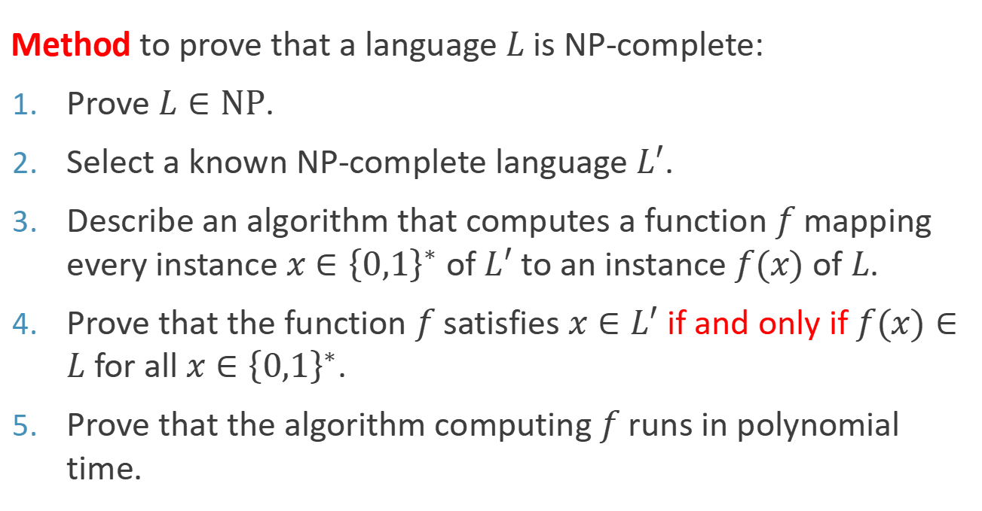
NP-Completeness Proofs 证明NPC的5个步骤
Method to prove that a language $L$ is NP-complete:
Prove $L∈NP$.
Select a known NP-complete language $L′$.
Describe an algorithm that computes a function $f$ mapping every instance $x∈{\left\{0,1\right\}}^{∗}$ of $L′$ to an instance $f(x)$ of $L$.
Prove that the function $f$ satisfies $x∈L′$ if and only if $f(x)∈L$ for all $x∈{\left\{0,1\right\}}^{∗}$.
Prove that the algorithm computing $f$ runs in polynomial time.

Slide 60
NP-Completeness Proofs
Things seem to be easy now, we can use an NPC problem to prove more NPC problems.
However, where is the first NPC problem?
Notes:
那问题就变得太简单了, 但是仔细一想, 真的有那么简单吗?
变成了鸡生蛋, 蛋生鸡的问题, 你要证明一个问题是NPC, 得先要有一个别的问题是NPC.

Slide 61
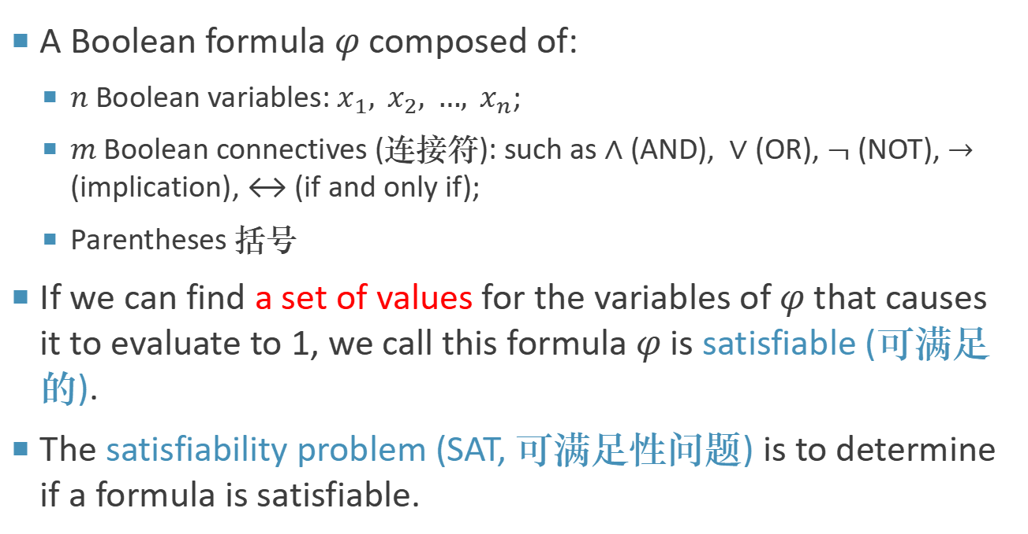
Satisfiability Problem 可满足问题
A Boolean formula $φ$ composed of:
$n$ Boolean variables: $x_{1}, x_{2}, …, x_{n}$;
$m$ Boolean connectives (连接符): such as $∧$ (AND), $∨$ (OR), $¬$ (NOT), $→$ (implication), ↔ (if and only if);
Parentheses 括号
If we can find a set of values for the variables of $φ$ that causes it to evaluate to 1, we call this formula $φ$ is satisfiable (可满足的).
The satisfiability problem (SAT, 可满足性问题) is to determine if a formula is satisfiable.
Notes:
φ对应\varphi

Slide 62
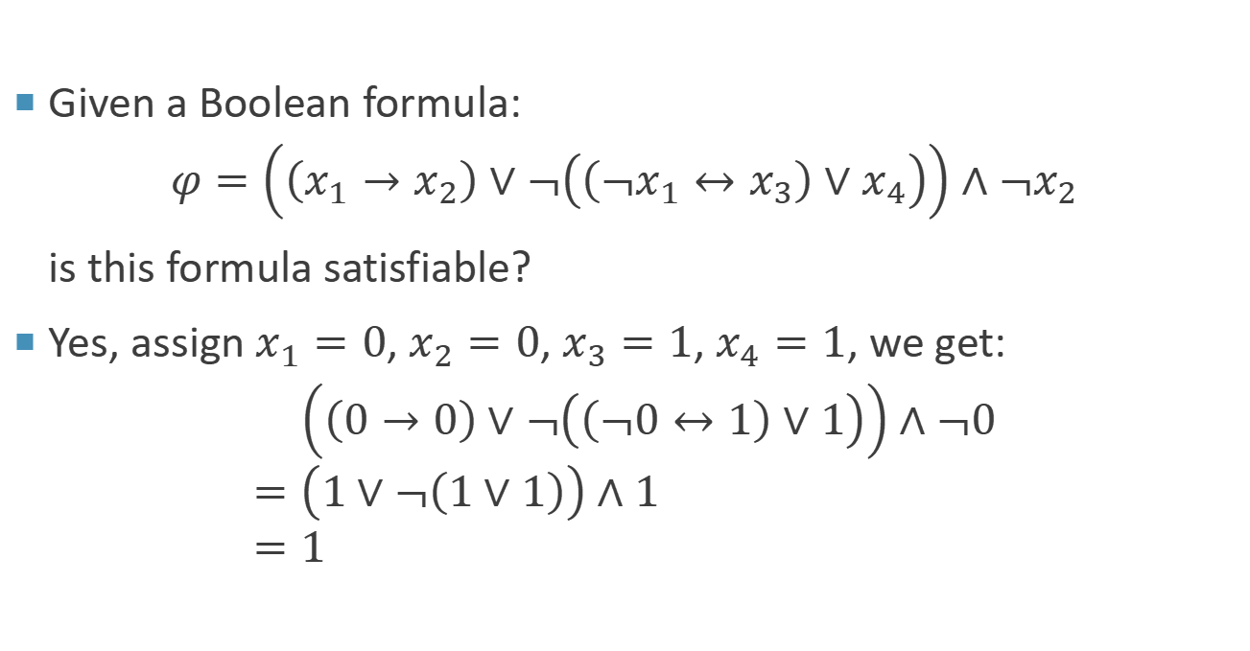
Example
Given a Boolean formula:
$$φ=\left(\left(x_{1}→x_{2}\right)∨¬\left(\left(¬x_{1}↔x_{3}\right)∨x_{4}\right)\right)∧¬x_{2}$$
is this formula satisfiable?
Yes, assign $x_{1}=0$, $x_{2}=0$, $x_{3}=1$, $x_{4}=1$, we get:
$$\left(\left(0→0\right)∨¬\left(\left(¬0↔1\right)∨1\right)\right)∧¬0 \\ =\left(1∨¬\left(1∨1\right)\right)∧1 \\ =1$$
A → B 等价于 ¬A ∨ B（非A或B）。
Notes:
首先，我们需要理解给定的布尔公式中的各个操作符：
→ 表示逻辑蕴含，A → B 等价于 ¬A ∨ B（非A或B）。
∨ 表示逻辑或。
∧ 表示逻辑与。
¬ 表示逻辑非。

Slide 63
Satisfiability Problem
Theorem 11.4
SAT is NP-complete.
In 1971, Stephen Cook proves the first NPC problem.
This problem itself is not interesting at all.
However, we can use it to prove NP-completeness of other problems.
Stephen Cook
Turing Award in 1982
Image source: https://en.wikipedia.org/wiki/Stephen_Cook
Notes:
打响了NP完全的第一枪

Slide 64
Satisfiability Problem
Proof:
Show that SAT is in NP.
The verifying algorithm simply replaces each variable in the formula with its corresponding value and then evaluates the expression.
This task is easily done in polynomial time.
If the expression evaluates to 1, the formula is satisfiable.
Show that SAT is NP-hard.
Not that easy to prove.

Slide 65
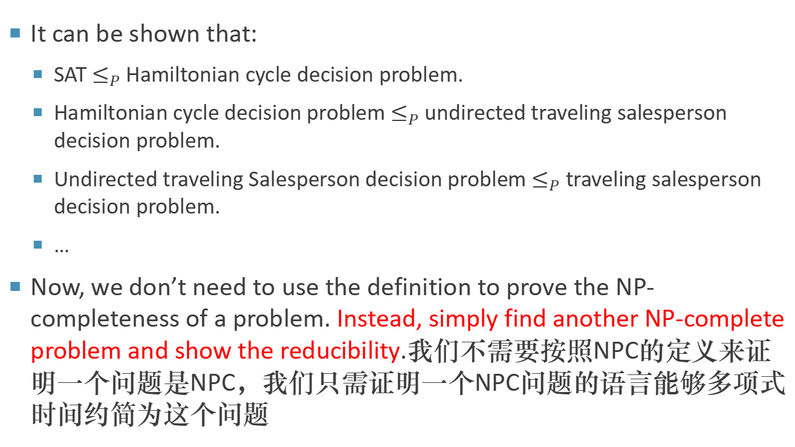
Satisfiability Problem
It can be shown that:
SAT $≤_{P}$ Hamiltonian cycle decision problem.
Hamiltonian cycle decision problem $≤_{P}$ undirected traveling salesperson decision problem.
Undirected traveling Salesperson decision problem $≤_{P}$ traveling salesperson decision problem.
…
Now, we don’t need to use the definition to prove the NP-completeness of a problem. Instead, simply find another NP-complete problem and show the reducibility.我们不需要按照NPC的定义来证明一个问题是NPC，我们只需证明一个NPC问题的语言能够多项式时间约简为这个问题
Notes:
可以证明：
SAT问题在多项式时间归约下可转换为哈密顿回路决策问题。
哈密顿回路决策问题在多项式时间归约下可转换为无向旅行商决策问题。
无向旅行商决策问题在多项式时间归约下可转换为旅行商决策问题。

Slide 66
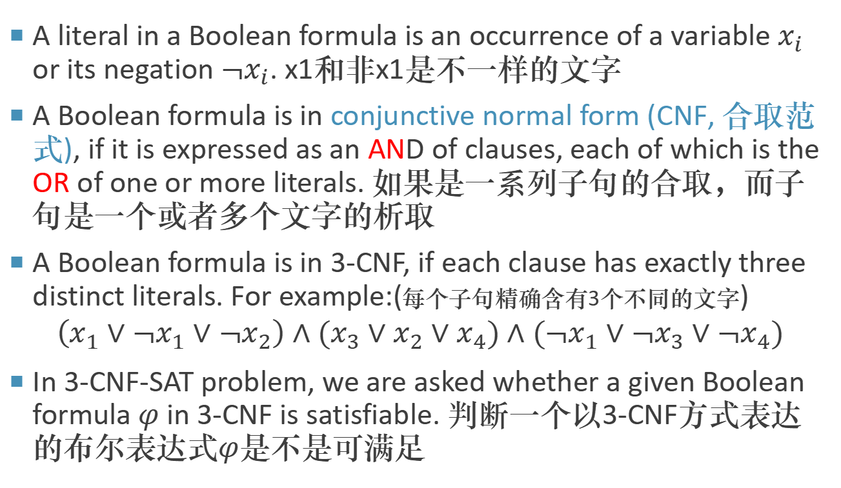
3-CNF Satisfiability
A literal in a Boolean formula is an occurrence of a variable $x_{i}$ or its negation $¬x_{i}$. x1和非x1是不一样的文字
A Boolean formula is in conjunctive normal form (CNF, 合取范式), if it is expressed as an AND of clauses, each of which is the OR of one or more literals. 如果是一系列子句的合取，而子句是一个或者多个文字的析取
A Boolean formula is in 3-CNF, if each clause has exactly three distinct literals. For example:(每个子句精确含有3个不同的文字)
$$\left(x_{1}∨¬x_{1}∨¬x_{2}\right)∧(x_{3}∨x_{2}∨x_{4})∧(¬x_{1}∨¬x_{3}∨¬x_{4})$$
In 3-CNF-SAT problem, we are asked whether a given Boolean formula $φ$ in 3-CNF is satisfiable. 判断一个以3-CNF方式表达的布尔表达式$φ$是不是可满足
Notes:
x1和非x1是不一样的文字
3-CNF 在中文里通常读作 “三阶合取范式” 或 “三元合取范式”。这里的“3”表示每个子句（clause）中的文字（literal）数量最多为3

Slide 67
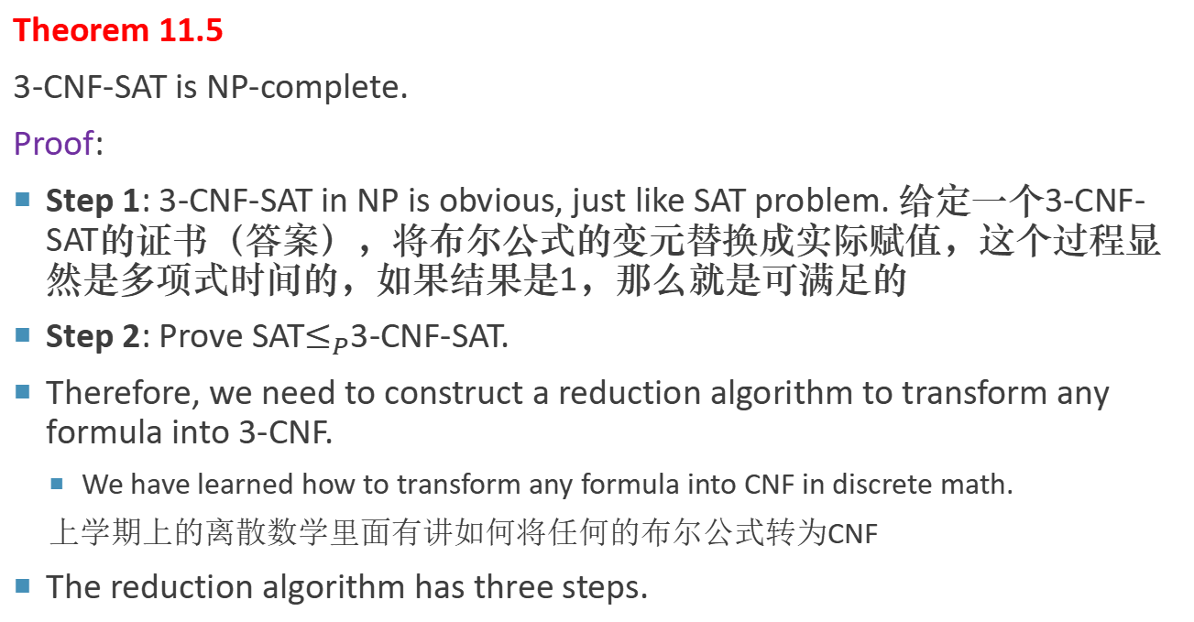
NP-Completeness of 3-CNF Satisfiability
Theorem 11.5
3-CNF-SAT is NP-complete.
Proof:
Step 1: 3-CNF-SAT in NP is obvious, just like SAT problem. 给定一个3-CNF-SAT的证书（答案），将布尔公式的变元替换成实际赋值，这个过程显然是多项式时间的，如果结果是1，那么就是可满足的
Step 2: Prove SAT$≤_{P}$3-CNF-SAT.
Therefore, we need to construct a reduction algorithm to transform any formula into 3-CNF.
We have learned how to transform any formula into CNF in discrete math.
上学期上的离散数学里面有讲如何将任何的布尔公式转为CNF
The reduction algorithm has three steps.
Notes:
本质上就是在证明, 任何公式都可以转化为3-CNF
先给例子让大家试一下

Slide 68
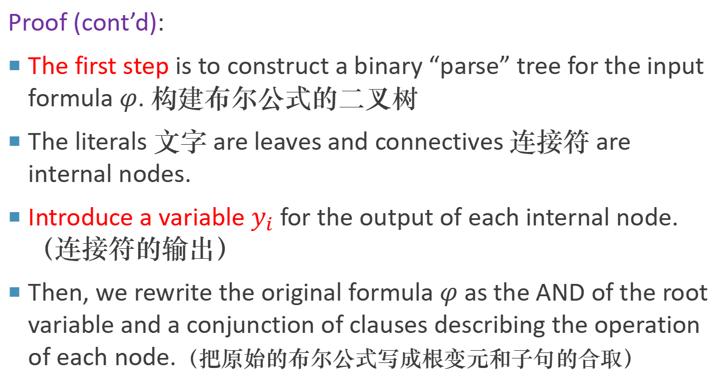
NP-Completeness of 3-CNF Satisfiability
Proof (cont’d):
The first step is to construct a binary “parse” tree for the input formula $φ$. 构建布尔公式的二叉树
The literals 文字 are leaves and connectives 连接符 are internal nodes.
Introduce a variable $y_{i}$ for the output of each internal node. （连接符的输出）
Then, we rewrite the original formula $φ$ as the AND of the root variable and a conjunction of clauses describing the operation of each node.（把原始的布尔公式写成根变元和子句的合取）

Slide 69




















NP-Completeness of 3-CNF Satisfiability
$$φ=\left(\left(x_{1}→x_{2}\right)∨¬\left(\left(¬x_{1}↔x_{3}\right)∨x_{4}\right)\right)∧¬x_{2}$$
$$y_{1}$$
$$∧$$
$$y_{2}$$
$$φ^{′}=y_{1}∧\left(y_{1}↔\left(y_{2}∧¬x_{2}\right)\right) \\ ∧\left(y_{2}↔\left(y_{3}∨y_{4}\right)\right) \\ ∧\left(y_{3}↔\left(x_{1}→x_{2}\right)\right) \\ ∧\left(y_{4}↔¬y_{5}\right) \\ ∧\left(y_{5}↔\left(y_{6}∨x_{4}\right)\right) \\ ∧\left(y_{6}↔\left(¬x_{1}↔x_{3}\right)\right)$$
$$∨$$
$$¬x_{2}$$
$$y_{3}$$
$$y_{4}$$
$$→$$
$$¬$$
$$x_{1}$$
$$x_{2}$$
$$y_{5}$$
$$∨$$
$$y_{6}$$
$$↔$$
$$x_{4}$$
$φ^{′}$ is conjunction of clause $φ_{i}^{′}$. Each clause $φ_{i}^{′}$ has at most 3 literals.
$$¬x_{1}$$
$$x_{3}$$

Slide 70

NP-Completeness of 3-CNF Satisfiability
Proof (cont’d):
The second step converts each clause $φ_{i}$ into CNF. 第二步将每个子句都变成合取范式CNF
Construct a truth table for $φ_{i}$ by evaluating all possible assignments to its variables. 首先对每个子句$φ_{i}$构建真值表
Build a formula in disjunctive normal form (DNF, 析取范式) that is equivalent to $¬φ_{i}$. 之后基于真值表构建析取范式
Convert $¬φ_{i}$ into CNF $φ_{i}$ by using DeMorgan’s laws (德・摩根法则) to complement all literals and switch OR and AND.
Notes:
再次注意, 作为计科人, 看到DNF, 要先想到析取范式
Leonardo da vinci

Slide 71


NP-Completeness of 3-CNF Satisfiability
For example:
$$φ_{2}^{′}=y_{1}↔\left(y_{2}∧¬x_{2}\right)$$
The DNF formula equivalent to $¬φ_{2}′$ is
$$\left(y_{1}∧y_{2}∧x_{2}\right)∨(y_{1}∧¬y_{2}∧x_{2})∨(y_{1}∧¬y_{2}∧¬x_{2})∨(¬y_{1}∧y_{2}∧¬x_{2})$$
Applying DeMorgan’s laws, we get $φ_{2}^{′′}$:
$$(¬ y_{1}∨¬ y_{2}∨¬ x_{2})∧(¬ y_{1}∨y_{2}∨¬ x_{2})∧(¬ y_{1}∨y_{2}∨x_{2})∧(y_{1}∨¬ y_{2}∨x_{2})$$
$$y_{1}$$ | $$y_{2}$$ | $$x_{2}$$ | $$(y_{1}↔(y_{2}∧¬x_{2}))$$
$$1$$ | $$1$$ | $$1$$ | $$0$$
$$1$$ | $$1$$ | $$0$$ | $$1$$
$$1$$ | $$0$$ | $$1$$ | $$0$$
$$1$$ | $$0$$ | $$0$$ | $$0$$
$$0$$ | $$1$$ | $$1$$ | $$1$$
$$0$$ | $$1$$ | $$0$$ | $$0$$
$$0$$ | $$0$$ | $$1$$ | $$1$$
$$0$$ | $$0$$ | $$0$$ | $$1$$
Notes:
事实上, 离散数学我们都学过, 我们很容易构造出一个合取范式, 为什么要这么麻烦呢?
因为我们需要构造出一个转化的算法, 你要让计算机知道怎么做.

Slide 72

NP-Completeness of 3-CNF Satisfiability
Proof (cont’d):
The final step further transforms the formula so that each clause has exactly 3 distinct literals. 最后一步让每个子句都有3个文字
If $φ_{i}′′$ has 3 distinct literals, then simply include $φ_{i}′′$ as clauses of $φ′′′$.
If $φ_{i}′′$ has 2 distinct literals $l_{1}$ and $l_{2}$, that is, if $φ_{i}′′=(l_{1}∨l_{2})$, then include $\left(l_{1}∨l_{2}∨p\right)∧(l_{1}∨l_{2}∨¬p)$ as clauses of $φ′′′$.
If $φ_{i}′′$ has just 1 distinct literal $l$, then include $\left(l∨p∨q\right)∧(l∨p∨¬q)∧(l∨¬p∨q)∧(l∨¬p∨¬q)$ as clauses of $φ′′′$.
$p$ and $q$ can be arbitrary literal.

Slide 73

NP-Completeness of 3-CNF Satisfiability
Proof (cont’d):
Thus, every formular can be transformed into 3-CNF $φ′′′$, and $φ′′′$ is satisfiable if and only if $φ$ is satisfiable.
This reduction algorithm is polynomial time.
Therefore, 3-CNF is NPC.

Slide 74

Clique Problem 团问题
Now, we have known two NPC problem: SAT and 3-CNF-SAT. We can use them to prove more NPC problems.
A clique (团) is a complete subgraph of an undirected graph $G=(V,E)$.
Each pair of vertex in $V^{′}⊆V$is connected by an edge in $E$. 任意一对顶点之间都有边直接相连
The size of a clique is the number of vertices it contains. 一个团的大小指的是这个团里面的节点数量
The clique problem is the optimization problem of finding a clique of maximum size in a graph. 团问题的优化问题指给定一个图，找一个团，使得其节点数量最多。
As a decision problem, we ask simply whether a clique of a given size $k$ exists in the graph. 团问题的判定问题是问到底指定大小的团是不是在图中存在

Slide 75


Clique Problem
The brute force algorithm finds a 4-clique in this 7-vertex graph.
Systematically check all $C(7,4)=35$ subgraphs with 4 vertices for completeness.
Image source: https://en.wikipedia.org/wiki/Clique_problem
Notes:
需要检查35种不同的方式来选择4个顶点构成的子图。对于每一种选择，我们需要检查这些顶点之间是否都有边相连，以确保子图是完整的。在图论中，一个完全图是指每一对不同的顶点之间都恰好有一条边相连的图。

Slide 76

Clique Problem
Theorem 11.6
Clique is NP-complete.
Proof:
Step 1: We first prove clique is in NP.
For a given graph $G=(V,E)$, we use the set $V^{′}⊆V$ of vertices in the clique and a integer $k$ as a certificate for $G$.
Checking whether $V′$ is a clique can be accomplished in polynomial time by checking whether $\left(u,v\right)∈E$, $∀u, v∈V′$.
Then, compare $|V′|$ with $k$ and return True or False.

Slide 77

Clique Problem
Proof (cont’d):
Step 2: We next prove that 3-CNF-SAT $≤_{P}$ Clique, which shows that the clique problem is NP-hard.
That we should be able to prove this result is somewhat surprising, since logical formulas seem to have little to do with graphs.
We need to construct a reduction algorithm that transforms any instance of 3-CNF-SAT into an instance of clique.
Notes:
接下来就是见证奇迹的时刻, 3-CNF-SAT和团问题, 有半毛钱关系???

Slide 78

Clique Problem
Proof (cont’d):
Let $φ$ be a Boolean formula in 3-CNF with $k$ clauses: 这个CNF有$k$个子句
$$φ=C_{1}∧C_{2}∧…∧C_{k}$$
For $r=1,2,…,k$, each clause $C_{r}$ has exactly three distinct literals $l_{1}^{r}$, $l_{2}^{r}$ and $l_{3}^{r}$:
$$C_{r}=l_{1}^{r}∨l_{2}^{r}∨l_{3}^{r}$$
Now, we construct a graph $G$ such that $φ$ is satisfiable if and only if $G$ has a clique of size $k$. 构造一个图， $φ$可满足当且仅当$G有$大小为$k$的团
Notes:
k个子句

Slide 79










Clique Problem
Proof (cont’d):
The graph $G=(V,E)$ is constructed as follows.
For each clause $C_{r}=l_{1}^{r}∨l_{2}^{r}∨l_{3}^{r}$ in $φ$, we place a triple of vertices $l_{1}^{r}$, $l_{2}^{r}$ and $l_{3}^{r}$into $V$.
For example:
$$φ=\left(x_{1}∨¬x_{2}∨¬x_{3}\right) \\ ∧\left(¬x_{1}∨x_{2}∨x_{3}\right) \\ ∧\left(x_{1}∨x_{2}∨x_{3}\right)$$
$$\left(x_{1}∨¬x_{2}∨¬x_{3}\right)$$
$$x_{1}$$
$$¬x_{2}$$
$$¬x_{3}$$
$${¬x}_{1}$$
$$x_{1}$$
$$x_{2}$$
$$x_{2}$$
$$x_{3}$$
$$x_{3}$$
$$\left(¬x_{1}∨x_{2}∨x_{3}\right)$$
$$\left(x_{1}∨x_{2}∨x_{3}\right)$$

Slide 80

Clique Problem
Proof (cont’d):
We put an edge between two vertices $l_{i}^{r}$ and $l_{j}^{s}$ if both of the following hold:
$l_{i}^{r}$ and $l_{j}^{s}$are in different triples, that is, $r≠s$.
$l_{i}^{r}$ is not the negation of $l_{j}^{s}$.
This graph can easily be computed from $φ$ in polynomial time.
$$\left(x_{1}∨¬x_{2}∨¬x_{3}\right)$$
$$x_{1}$$
$$¬x_{2}$$
$$¬x_{3}$$
$${¬x}_{1}$$
$$x_{1}$$
$$x_{2}$$
$$x_{2}$$
$$x_{3}$$
$$x_{3}$$
$$\left(¬x_{1}∨x_{2}∨x_{3}\right)$$
$$\left(x_{1}∨x_{2}∨x_{3}\right)$$

Slide 81

Clique Problem
Proof (cont’d):
A satisfiable assignment is:
$$x_{2}=0, x_{3}=1$$
and $x_{1}$ cam be either 0 or 1. The corresponding 3-clique is:
$$\{¬x_{2},x_{3},x_{3}\}$$
Another satisfiable assignment is:
$$x_{1}=1, x_{2}=1$$
and $x_{3}$ cam be either 0 or 1. The corresponding 3-clique is:
$$\{x_{1},x_{2},x_{2}\}$$
$$\left(x_{1}∨¬x_{2}∨¬x_{3}\right)$$
$$x_{1}$$
$$¬x_{2}$$
$$¬x_{3}$$
从不同子句中选取使得子句为真的文字
$${¬x}_{1}$$
$$x_{1}$$
$$x_{2}$$
$$x_{2}$$
$$x_{3}$$
$$x_{3}$$
$$\left(¬x_{1}∨x_{2}∨x_{3}\right)$$
$$\left(x_{1}∨x_{2}∨x_{3}\right)$$

Slide 82


Clique Problem
Proof (cont’d):
We must show that this transformation of $φ$ into $G$ is a reduction, i.e. $φ$ is satisfiable if and only if $G$ has $k$-clique. 必须证明$φ$是可满足的，当且仅当$G有$K大小的团
We first prove $⟹$. Suppose that $φ$ has a satisfying assignment.
Then each clause $C_{r}$ contains at least one literal that is assigned 1. 每个子句至少一个文字是真
$$φ=\left(x_{1}∨¬x_{2}∨¬x_{3}\right)∧\left(¬x_{1}∨x_{2}∨x_{3}\right)∧\left(x_{1}∨x_{2}∨x_{3}\right)$$
Picking one such "true" literal from each clause yields a set $V′$ of $k$ vertices.
It is easy to show that $V′$ is a clique by the construction of $G$.（任意两个顶点
属于不同子句，赋值1不是文字的非，根据图的构造，是一个团）
1
1
1

Slide 83

Clique Problem
Proof (cont’d):
Then we prove $⟸$. Suppose that $G$ has a clique $V′$ of size $k$.
No edges in $G$ connect vertices in the same triple, and so $V′$ contains exactly one vertex per triple. 同一个子句的文字，对应顶点在G中没有连接，V’包含了每个子句中的一个文字
Assigning 1 to each literal is safe, because $G$ contains no edges between complementary literals. 相反的文字不会在同一条边中出现，只需要对V’中文字进行赋值为1，那么整个$φ取值$为1
Each clause is satisfied, and so $φ$ is satisfied.

Slide 84

Vertex Cover Problem 顶点覆盖问题
A vertex cover (顶点覆盖) of an undirected graph $G=(V,E)$ is a subset $V’⊆V$ such that if $(u,v)$ is an edge of $G$, then either $u∈V’$ or $v∈V’$ (or both).
顶点覆盖问题中，任选一条边，他的两个顶点中，至少有一个在覆盖顶点V’中
The size of a vertex cover is the number of vertices in it.
The vertex-cover problem is to find a vertex cover of minimum size in a given undirected graph.
We can prove the completeness of vertex cover problem by showing Clique $≤_{P}$ VertexCover. 通过证明团问题可以归约到顶点覆盖问题，来证明他是NPC
A vertex cover
An minimum vertex cover
Image source: https://en.wikipedia.org/wiki/Vertex_cover
Notes:
一环套一环, 所以为什么可满足性问题那么重要, 因为是第一个, 所以能拿图灵奖

Slide 85









Vertex Cover Problem
We first introduce the notion of complement graph (补图).
Given an undirected graph $G=(V,E)$, we define the complement of $G$ as $\overline{G}=(V,\overline{E})$ , where $\overline{E}=\{\left(u,v\right):u,v∈V and \left(u,v\right)∉E\}$.
补图：顶点还是原来的顶点，但是边都是原来图中不存在的边
$$u$$
$$v$$
$$z$$
$$w$$
$$y$$
$$x$$
$$G$$
$$u$$
$$v$$
$$z$$
$$w$$
$$y$$
$$x$$
$$\overline{G}$$

Slide 86

Vertex Cover Problem
Proof:
We first show that VertexCover ∈ NP.
Suppose we are given a graph $G=(V,E)$ and an integer $k$.
The certificate we choose is the vertex cover $V^{′}⊆V$ itself.
The verification algorithm affirms that $|V′|=k$, and then it checks:
$u∈V’$ or $v∈V’$, $∀\left(u,v\right)∈E$
This verification can be performed straightforwardly in polynomial time.

Slide 87

Vertex Cover Problem
Proof (cont’d):
The reduction algorithm takes as input an instance $⟨G,k⟩$ of the clique problem.
It computes the complement $\overline{G}$, which is easily done in polynomial time. 计算图的补图$\overline{G}$
The output of the reduction algorithm is the instance $⟨\overline{G},\left|V\right|−k⟩$ of the vertex-cover problem. 对团问题进行约简，约简为其补图的顶点覆盖问题
To complete the proof, we show that this transformation is indeed a reduction:
⟨𝐺,𝑘⟩ of the clique problem
$⟨\overline{G},\left|V\right|−k⟩$ of the vertex-cover problem
只需证明：图G有一个大小k的团当且仅当图$\overline{G}$有一个大小$\left|V\right|−k$的顶点覆盖

Slide 88






Vertex Cover Problem
Proof (cont’d):
$$u$$
$$v$$
$$u$$
$$v$$
$$z$$
$$w$$
$$z$$
$$w$$
$$y$$
$$x$$
$$y$$
$$x$$
$$G$$
$$\overline{G}$$
Clique size = 4
Vertex cover = 6 – 4 = 2
只需证明：图G有一个大小k的团当且仅当图$\overline{G}$有一个大小$\left|V\right|−k$的顶点覆盖

Slide 89



Vertex Cover Problem
Proof (cont’d):
We first prove $⟹$. Suppose that $G$ has a clique $V’⊆V$ with $|V′|=k$.
Since every pair of vertices in $V′$ is connected by an edge of $E$, if $(u,v)∉E$, which implies that at least one of $u$ or $v$ does not belong to $V′$. 在团$V′$中，每个点都通过E中边相连，如果有一条边$(u,v)$ 不属于E，那么意味着u或者v不属于V’
$$V^{′}=\{u,v,x,y\}$$
$$u$$
$$v$$
$$z$$
$$w$$
$$y$$
$$x$$
$$G$$
$$u$$
$$v$$
$$z$$
$$w$$
$$y$$
$$x$$
$$V−V^{′}=\{z,w\}$$
$$\overline{G}$$
只需证明：图G有一个大小k的团当且仅当图$\overline{G}$有一个大小$\left|V\right|−k$的顶点覆盖
Notes:
（由团证明覆盖）团，大小k，对于不属于e的边，肯定在G补图里，这些边的顶点至少一个不属于V’

Slide 90

Vertex Cover Problem
$$V^{′}=\{u,v,x,y\}$$
Proof (cont’d):
We get: $\left(u,v\right)∈\overline{E}⇒$ $u∈V−V′$ or $v∈V−V′$
It means that every edge $(u,v)∈\overline{E}$ is covered by $V−V′$. 这个就是顶点覆盖
Hence, the set $V−V′$,which has size $|V|−k$, forms a vertex cover for $\overline{G}$.
$$u$$
$$v$$
$$z$$
$$w$$
$$y$$
$$x$$
$$G$$
$$u$$
$$v$$
$$z$$
$$w$$
$$y$$
$$x$$
$$V−V^{′}=\{z,w\}$$
$$\overline{G}$$
只需证明：图G有一个大小k的团当且仅当图$\overline{G}$有一个大小$\left|V\right|−k$的顶点覆盖

Slide 91



Vertex Cover Problem
$${V−V}^{′}=\{u,v,x,y\}$$
Proof (cont’d):
Then we prove $⟸$. Suppose that $\overline{G}$ has a vertex cover $V^{′}⊆V$, where $|V′|=|V|−k$.
Then, $∀u, v∈V$:
$\left(u,v\right)∈\overline{E}$ ⇒ $u∈V^{′} or v∈V′$
The contrapositive of this implication is:
$\left(u,v\right)∉\overline{E}$ ⇐ $u∉V^{′} and v∉V′$
$$u$$
$$v$$
$$z$$
$$w$$
$$y$$
$$x$$
$$G$$
$$u$$
$$v$$
$$z$$
$$w$$
$$y$$
$$x$$
$$V^{′}=\{z,w\}$$
$$\overline{G}$$
只需证明：图G有一个大小k的团当且仅当图$\overline{G}$有一个大小$\left|V\right|−k$的顶点覆盖

Slide 92

Vertex Cover Problem
$${V−V}^{′}=\{u,v,x,y\}$$
Proof (cont’d):
$\left(u,v\right)∉\overline{E}$ ⇐ $u∉V^{′} and v∉V′$
$\left(u,v\right)∈E$ ⇐ $u∈V−V^{′} and v∈V−V^{′}$
In other words, $V−V′$ is a clique, and it has size $\left|V\right|−\left(\left|V\right|−k\right)=k$.
$$u$$
$$v$$
$$z$$
$$w$$
$$y$$
$$x$$
$$G$$
$$u$$
$$v$$
$$z$$
$$w$$
$$y$$
$$x$$
$$V^{′}=\{z,w\}$$
$$\overline{G}$$
只需证明：图G有一个大小k的团当且仅当图$\overline{G}$有一个大小$\left|V\right|−k$的顶点覆盖

Slide 93
NP-Completeness Proof Graph
SAT
3-CNF-SAT
Clique
GraphColoring
VertexCover
SetCover
TSP
HamCycle
SubsetSum
Knapsack
ParallelScheduling
Partition
BinPacking
StripPacking

Slide 94

Classroom Exercise （课堂练习）
The subset-sum problem (子集和问题) is defined as follows:
Given a sequence of integers $A=\{a_{1},…,a_{n},t\}$, determine whether there is a subset of the integers such that the sum is equal to $t$.
For example, given $\{a_{1}, a_{2}, a_{3}, a_{4}, a_{5},t\} = \{1, 6, 4, 3, 2, 8\}$, we have $a_{1}+a_{3}+a_{5}=8$.
The partition problem (划分问题) is defined as follows:
Given a sequence of integers $A=\{a_{1},…,a_{n}\}$, determine whether there is a partition into two subsets such that their sums are equal.
For example, given $\{a_{1}, a_{2}, a_{3}, a_{4}, a_{5}\} = \{1, 6, 4, 3, 2\}$, we have $a_{1}+a_{3}+a_{4}=a_{2}+a_{5}=8$.
If we know that subset-sum problem is NPC, prove that partition problem is NPC. 如果我们知道子集和问题是NPC，证明划分问题也是NPC

Slide 95

Classroom Exercise
Proof:
Step 1: Show that partition decision problem is in NP by checking its verification stage in polynomial-time or not.
Input: A set of index $S$.
Output: Yes or No.
$sum_{1}=\sum_{i∈S}{a_{i}}$, $sum_{2}=\sum_{i=1}^{n}{a_{i}}−sum_{1}$.
If $sum_{1}==sum_{2}$, return Yes; else return No.
It is obviously polynomial-time.

Slide 96

Classroom Exercise
Proof (cont’d):
Step 2: Prove that subset-sum $≤_{P}$ partition.
Compare the two problems:
Subset-Sum: Given $(a_{1},…,a_{n},t)$, where $t$ and all $a_{i}$ are integers, whether there exists an answer $S⊆\{1,…,n\}$ such that $\sum_{i∈S}{a_{i}}=t$.
Partition: Given $(a_{1},…,a_{n})$, where all $a_{i}$ are integers, whether there exists an answer $S⊆\{1,…,n\}$ such that $\sum_{i∈S}{a_{i}}=\sum_{j∉S}{a_{j}}$.

Slide 97

Classroom Exercise
Proof (cont’d):
Transform every instance of subset-sum to an instance of partition.
Let $x=(a_{1},…,a_{n},t)$ be an instance of subset-sum and $a=\sum_{i=1}^{n}{a_{i}}$. We define the transformation algorithm as
$$f(x) = (a_{1}, a_{2}, …, a_{n}, a_{n+1})$$
where $a_{n+1}=2t−a$.
It is clear that this transform can be done in polynomial time.
Then, we want to show that:
The answer $S$ to subset-sum problem is “yes” for $x$
$⟺$ The answer $S$ to partition problem is “yes” for $f(x)$.

Slide 98

Classroom Exercise
Proof (cont’d):
Prove $⟹$:
Let the answer $S⊆\{1,2,…,n\}$ to subset-sum problem is “yes” for $x$ such that $\sum_{i∈S}{a_{i}}=t$.
Let $T=\left\{1,2,…,n+1\right\}−S$, we have
$$\sum_{j∈T}{a_{j}}=a+a_{n+1}−t=a+2t−a−t=t=\sum_{i∈S}{a_{i}}.$$
Because $\sum_{i∈S}{a_{i}}=\sum_{j∈T}{a_{j}}=\sum_{j∉S}{a_{j}}$, the answer $S$ to partition problem is also “yes” for $f(x)$.

Slide 99

Classroom Exercise
Proof (cont’d):
Prove $⟸$:
If there exists the solution $S⊆\{1,2,…,n+1\}$ to partition problem is also “yes” for $f(x)$, such that letting $T=\left\{1,2,…,n+1\right\}−S$ we have
$$\sum_{i∈S}{a_{i}}=\sum_{j∈T}{a_{j}}=\frac{a+\left(2t−a\right)}{2}=t.$$
Without loss of generality, assume that $n+1∈T$, then we have $S⊆\{1,2,…,n\}$ and $\sum_{i∈S}{a_{i}}=t$.
Because $\sum_{i∈S}{a_{i}}=t$, the answer $S$ to subset-sum problem is also “yes” for $f(x)$.

Slide 100
Conclusion
After this lecture, you should know:
What is a polynomial-time algorithm.
What is a decision problem.
What are P and NP.
How a problem can be reduced to another problem.
What is an NP-complete problem.
What is an NP-hard problem.
How to prove NP-completeness of a problem.

Slide 101
Homework
Page 215-217
11.2
11.3
11.4
11.7
11.16

Slide 102
谢谢
有问题欢迎随时跟我讨论

